Slide 1
Mary MacNicholl Group Discussion & Tentative Schedule
Introductions and talk about your relationship to Mary Mac
Muriel phone call
Overview of my proposal, timeline review, preparation of essay w/proper citation for publication in the GCAH journal, and suggestions
Slide presentation
Break to bring lunch back to our room
Discuss essay

Slide 2
April, 2017, I felt called to research and write about Mary MacNicholl, my minister during my pre-teen and teen years
I had a feeling of pride for knowing her—but she was an aura—for my memories were blurred—I remembered only a few moments
MYF
Confirmation lessons-trip to Minneapolis
Choir
Singing chants—learning the meaning behind some of the music in the back of the hymnal
Seeing her sitting at our kitchen table with my mom drinking coffee and laughing and her attendance at MY graduation party
I felt I wanted to know more about her since most who I knew who knew her were no longer with us—so I thought
I expected to write a 5-7 page paper
The paper is now—”finished” and 33 pages, not including bibliography
BUT GOD HAD MORE IN STORE FOR ME TO FIND AND DO
Notes:
April, 2017, I felt called to research and write about Mary MacNicholl, my minister during my pre-teen and teen years
I had a feeling of pride for knowing her—but she was an aura—for my memories were blurred—I remembered only a few moments
MYF
Confirmation lessons-trip to Minneapolis
Choir
Singing chants—learning the meaning behind some of the music in the back of the hymnal
Seeing her sitting at our kitchen table with my mom drinking coffee and laughing and her attendance at MY graduation party
I felt I wanted to know more about her since most who I knew who knew her were no longer with us—so I thought
I expected to write a 5-7 page paper
The paper is now—”finished” and 33 pages, not including bibliography
BUT GOD HAD MORE IN STORE FOR ME TO FIND AND DO

Slide 3
The people and places I’ve met along my journey to find out more about Mary MacNicholl
Besides, ancestry.com, newspapers.com, google searches that have all basically run dry now
I’ve “met”
Muriel Hayward Neve
Mary Lee Ellis
Delton Kruegar
Pat Toschak
Jeanne Audrey Powers
Doug Norris
Ted Colescott
Kathy Johnson
Wykoff former parishioners—June Finke, Linda Montgomery
Beth Patkus, Conference Archivist
New York Annual Conference of the UMC
Cindy at Trinity UMC in Merchantville
Matthew Beland, Drew University archivist and Francis Lyons from General Conference on Archives and History, as well as those on the committee to honro me with a grant to write Mary’s story
Gary Klaven from Milan, MN
Phyllis Neal Cooper—first Church and Community Worker for the 9/10 Central MN Parish
Penny Fritze-Tietz--
Alfred T. Day at GCAH
The list goes on; I’m sure I’ve forgotten someone or something
Notes:
The people and places I’ve met along my journey to find out more about Mary MacNicholl
Besides, ancestry.com, newspapers.com, google searches that have all basically run dry now
I’ve “met”
Muriel Hayward Neve
Mary Lee Ellis
Delton Kruegar
Pat Toschak
Jeanne Audrey Powers
Doug Norris
Ted Colescott
Kathy Johnson
Wykoff former parishioners—June Finke, Linda Montgomery
Beth Patkus, Conference Archivist
New York Annual Conference of the UMC
Cindy at Trinity UMC in Merchantville
Matthew Beland, Drew University archivist and Francis Lyons from General Conference on Archives and History, as well as those on the committee to honro me with a grant to write Mary’s story
Gary Klaven from Milan, MN
Phyllis Neal Cooper—first Church and Community Worker for the 9/10 Central MN Parish
Penny Fritze-Tietz--
Alfred T. Day at GCAH
The list goes on; I’m sure I’ve forgotten someone or something

Slide 4
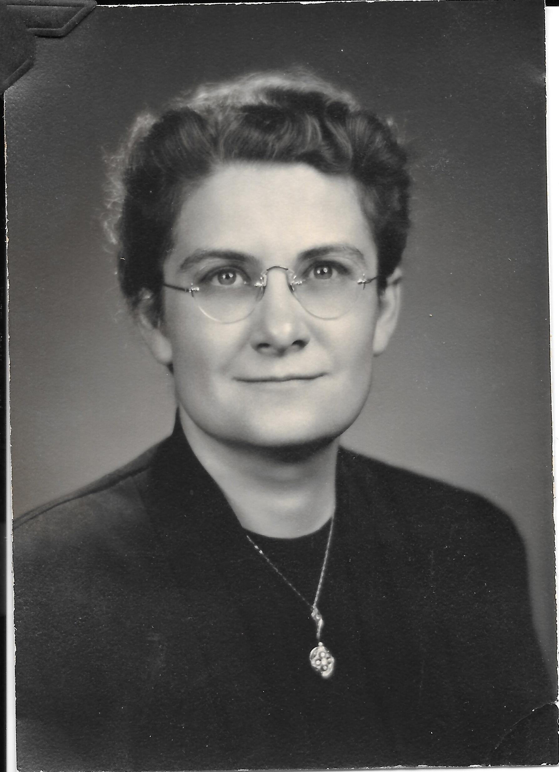
Mary MacNicholl:
A Woman with Vision
Minnesota’s first fully-ordained woman minister
of the Methodist Church
Photo provide by Muriel Neve

Slide 5
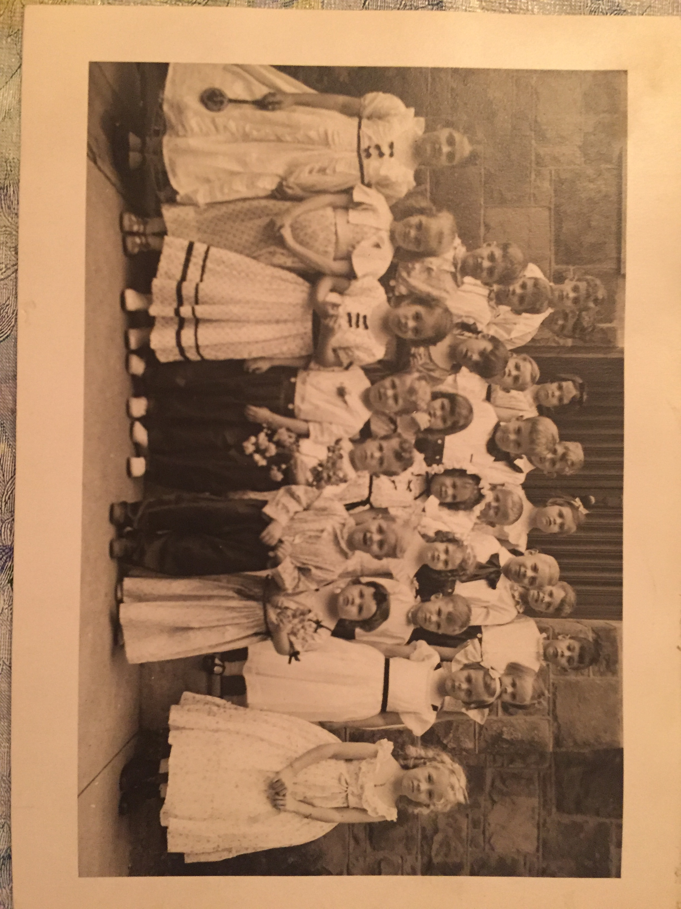
Mary MacNicholl ~1920
“Almost as if John and Charles Wesley,
the founders of Methodism,
could foresee one hundred plus years into the future and hand-pick her
from her family tree of ministers,
Mary MacNicholl felt an early call
to preach.”
She recalled “startling her first-grade teacher by announcing that she was going to school to become a Methodist minister.”
Image from Trinity UMC, Merchantville, NJ

Slide 6
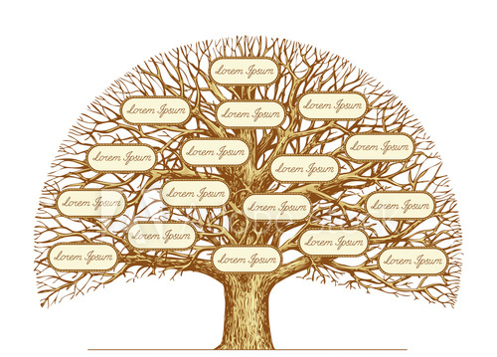
If she wanted, Mary could have traced her MacNicholl families, almost all zealot Methodists, back five generations to County Tyrone, Ireland.
Parents and grandparents on both sides loyal followers of John and Charles Wesley
Maternal grandmother was a member of the Wesleyan Methodist Church for 93 yrs. She died when she was 103.
In spite of persecution, paternal grandfather kept open house for itinerant preacher for over fifty years
Alexander McNicol, father
Mary Jane, mother
NYE UMC Conference “Memoirs”.. Images provided by Beth Patkus, Conference Archivist New York Annual Conference of the UMC
This Photo by Unknown Author is licensed under CC BY-NC-ND

Slide 7
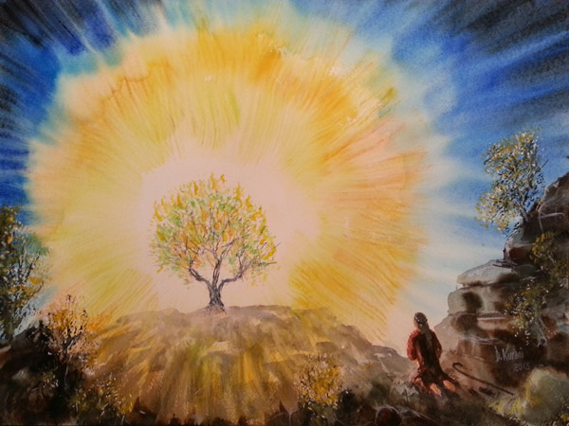
These early MacNicholls/McNicholls
were of an era
The Burning
Bush Variety
This Photo by Unknown Author is licensed under CC BY-NC-ND

Slide 8
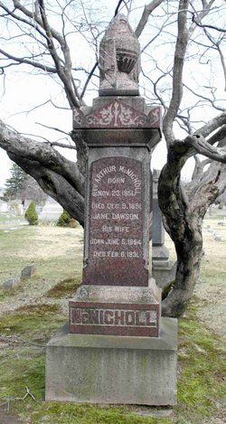
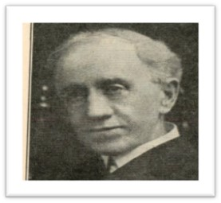
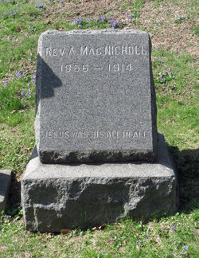
The Irish-born
MacNicholl brothers
Rev. Robert Turner MacNicholl “had the energy of John Wesley. . .
Providence had chosen
him for the work of a religious teacher and preacher and minister."
Rev. Arthur MacNicholl “converted” at sixteen and was licensed to preach when
he was nineteen.
He died when he was 40,
in 1891 in Connecticut.
By the 1930’s, along with Robert, Arthur, William, Alexander and son Alexander, the MacNicholls "had given one hundred and twenty-nine years of ministerial service to the New York East Conference.”
Rev. William MacNicholl “was mighty in prayer and . . . [h]is pulpit ministry was Biblical.”
Rev. Alexander MacNicholl
Some images provided by Beth Patkus, Conference Archivist New York Annual Conference of the UMC

Slide 9
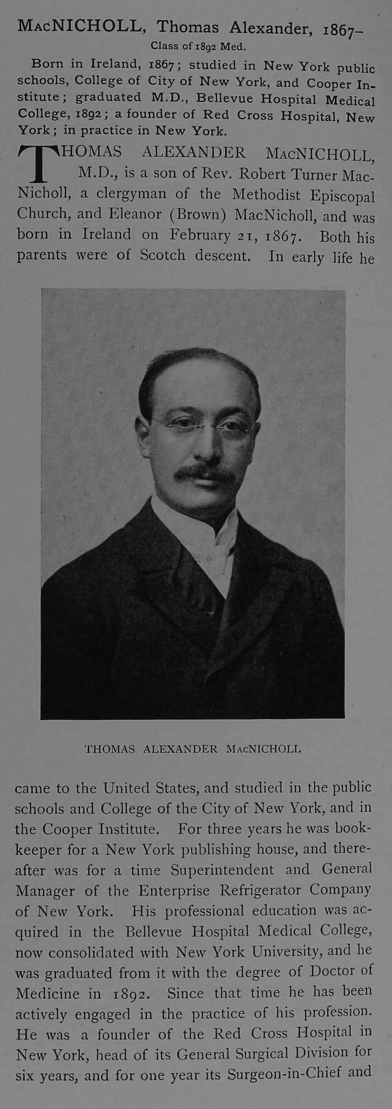
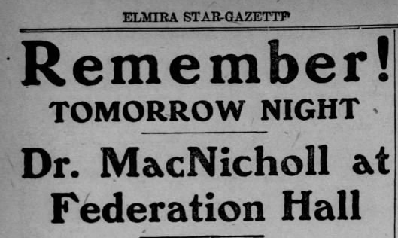
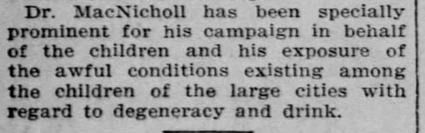
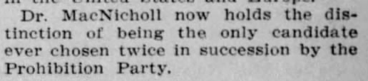
Dr. T. Alexander MacMicholl
“Whereas Reverend Robert Turner MacNicholl’s fight was on a spiritual plane, his oldest son, Dr. Thomas Alexander MacNicholl went further, carrying the crusade on medical terms.”
Star-Gazette
Elmira, New York
Wed, Oct 26, 1910 – 4

Slide 10
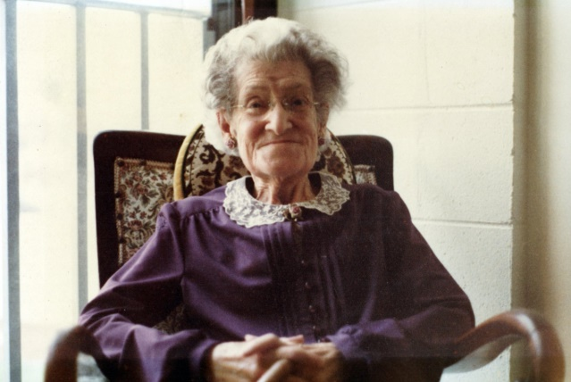
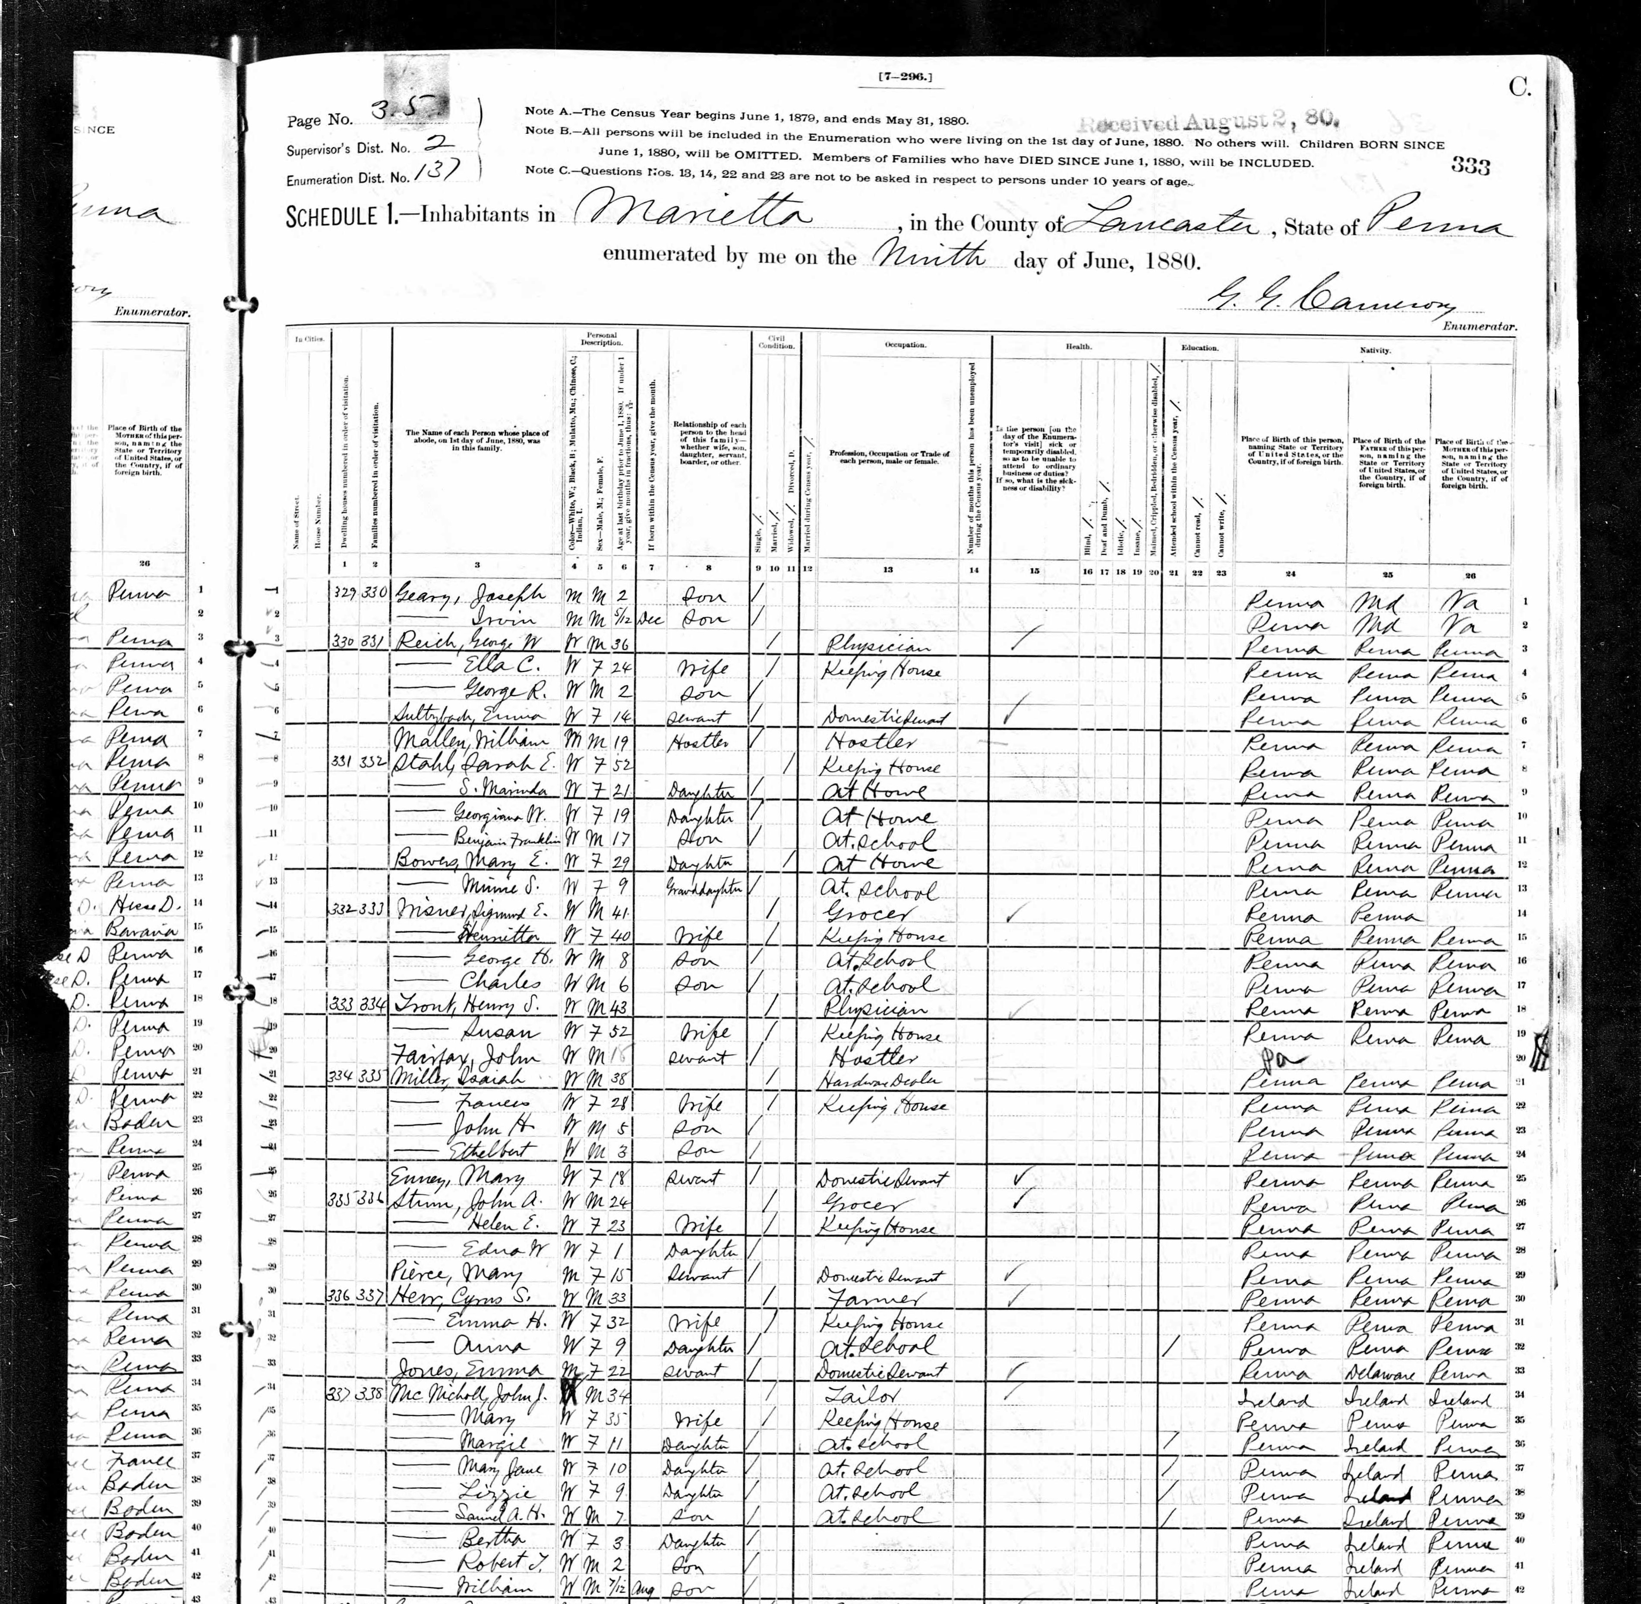
Mary’s grandfather, John MacNicholl, was equally attached to his faith
mostly to the detriment of his family
forged a path his children found hard to follow
Grandmother
Mary Rhodes MacNicholl
John MacNicholl was not successful as a tailor
he merely “wanted to read, write, and study the Bible,” Mary Lee Ellis, Mary’s cousin, states.

Slide 11
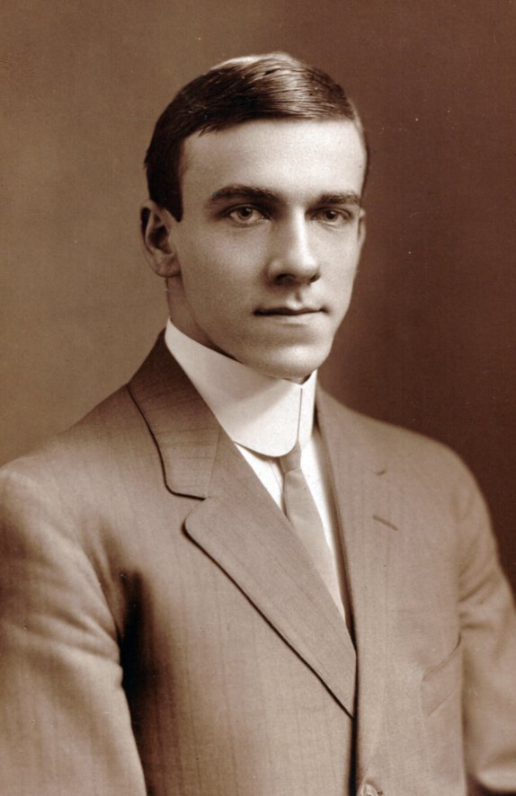
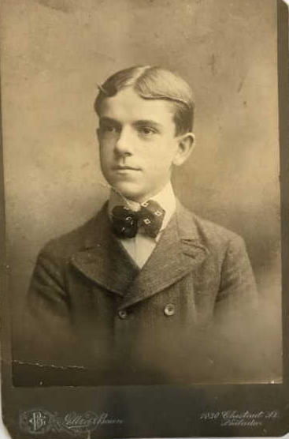
Brothers Arthur and Jay Alexander MacNicholl
Arthur and Jay had to go to work early in life. The two youngest children “helped care for their family with their wages.
Arthur MacNIcholl, Mary’s uncle
Jay MacNicholl, Mary’s father

Slide 12
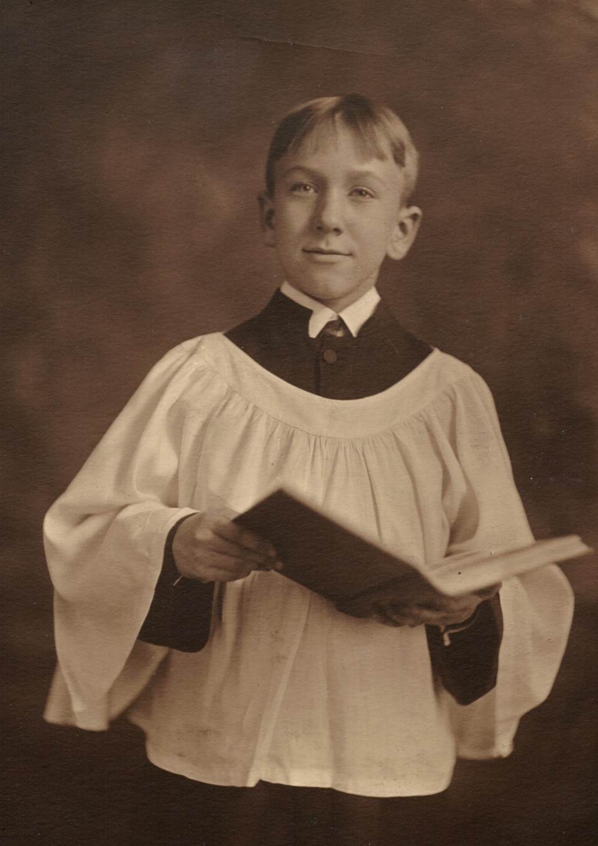
Sam, Mary’s cousin
Samuel Kirkpatrick MacNicholl, choir photo at Calvary Epicopal Church In Philadelphia, Pennsylvania.
When her Episcopalian
uncle Arthur came to the
Jay MacNicholl house
on Sundays with her cousin Samuel, Mary’s steeply-held Methodist constitution “wavered” when he was allowed to go outside to play, and even “borrow her roller skates.”
Mary was allowed only to sit
at the window
and “watch him skate.”

Slide 13
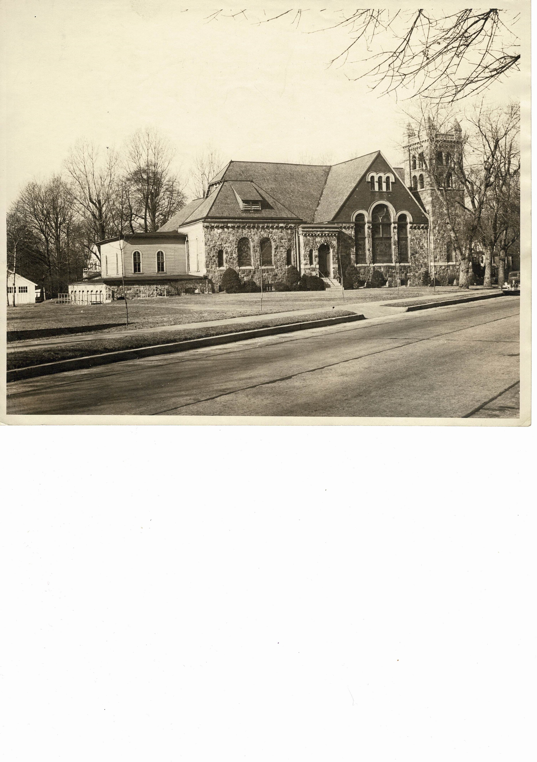
Merchantville, New Jersey, Methodist Church, March 1946

Slide 14
Children of Trinity Methodist Church ~ 1920
Mary
Jay’s family continued in the Methodist tradition. Mary MacNicholl wrote, “No drinking, no dancing, no card playing were the rules in my Methodist home.
Photo provided by Trinity UMC , Merchantville, NJ

Slide 15
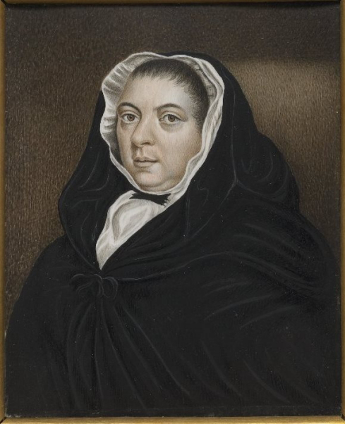
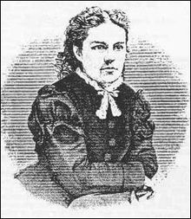
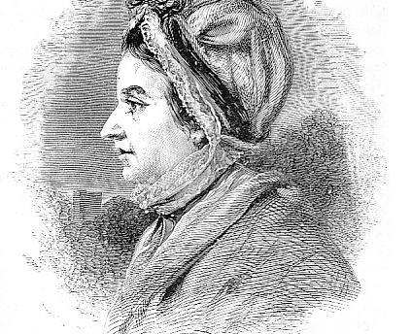
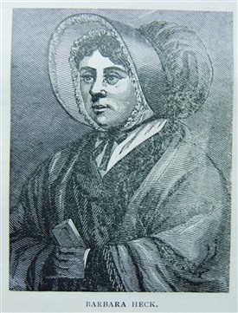
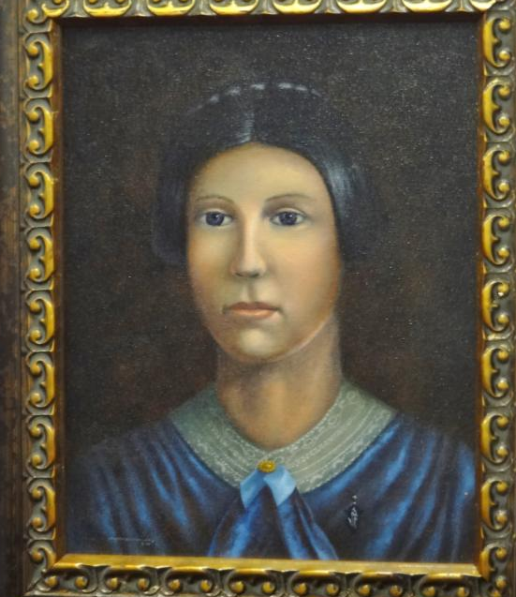
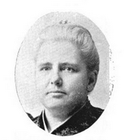
Mary MacNicholl would not be the first woman forging a path to serve her Lord.
Susana Wesley, The Mother of Methodism
Sarah Crosby
The first woman to hold the title of “minister.”
Mary Bousanquet Fletcher,
credited with convincing John Wesley (one of the founders of Methodism) to allow women to publicly preach
Barbara Heck, The Mother of American Methodism
Helenor Davisson The first ordained female
in the United States
Anna Shaw added suffrage, temperance, and peace to her ministerial convictions.

Slide 16
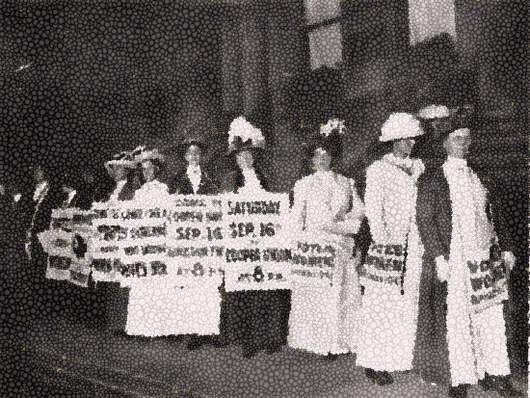
Mary MacNicholl was born during a turbulent time of the suffrage movement.
Some women starved themselves.
Others marched, road in carriages or on horses, and carried banners, supporting their cause in the famous New York City Women’s Suffrage Parade of 1915.
Newspapers castigated them, crowds hollered and heckled them, and some husbands dragged their wives by their hair to end their march.
Unfortunately, the pleas for women to go to the ballot booth continued to be ignored.

Slide 17
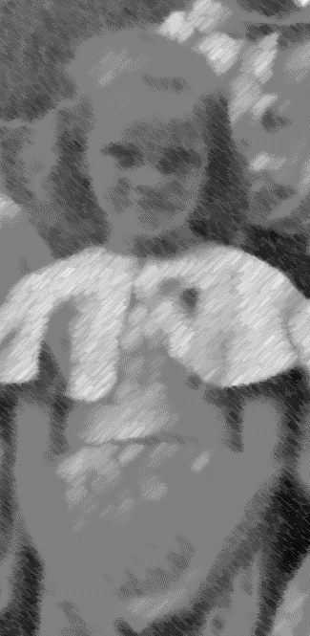
By 1920, when Mary MacNicholl was five,
women across the nation
celebrated the passing of the 19th Amendment.
Opportunities opened for them,
yet they still had to live in a man’s world,
deal with subordinating positions,
listen to both sexes voice their views on equality
Yet, Mary MacNicholl had a childhood dream
a path fostered by a robust, Scotch Irish Methodist family
and folded into a dedicated and welcoming heart.
It was time for Mary.

Slide 18
Mary MacNicholl had influential family members as well as many models to encourage and cheer her on to reach her goals.
The “mighty in prayer,” Uncle William MacNicholl suggested, “Always speak a good word for Jesus Christ, Mary.”
Her grandfather John Stoll reminded her of I. A. McLaren’s poem
to not be hard on anyone. Mary admitted though that she often was hard on others because “I am a person with rigid requirements. Because I fall down myself, I am inclined to hold others responsible” for their own mistakes.
Her father Jay MacNicholl, whom she loved,
tried to hold her back

Slide 19
In her autobiography,
Mary wrote she dated
only once,
“when I was 14.
My date implied
we could have a great time
if I would only
give up the idea
of being a minister.
I decided that was the end
of my dating.”

Slide 20
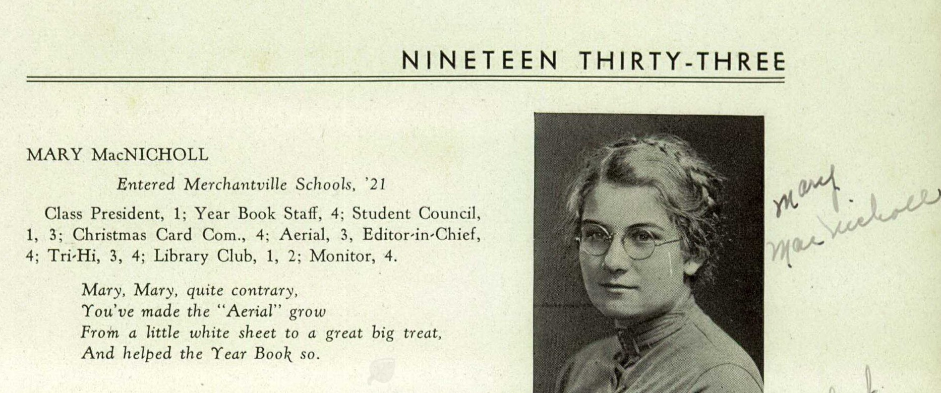
U.S., School Yearbooks, 1900-1990
Mary MacNicholl
Merchantville High School
New Jersey
From a young age, Mary worked hard
and followed a narrow path to achieve her goals.
She “rejected piano lessons in favor of voice,” so she could help her future congregations sing the good old hymns.
When she entered high school, she chose education over partying.

Slide 21
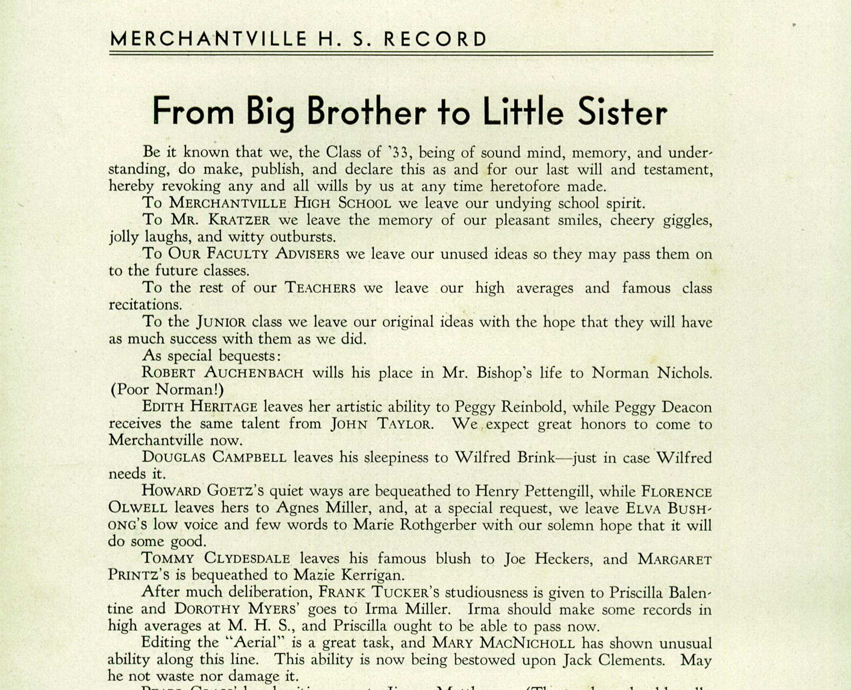
Life went on, after her two powerful influences died
and for the remainder of her school career at the Merchantville High School,
Mary was class president, a member of the student council, on the Christmas Card Committee and in Library Club. She was also Editor-in-Chief of the school newspaper and editor of the Record, the school yearbook.

Slide 22
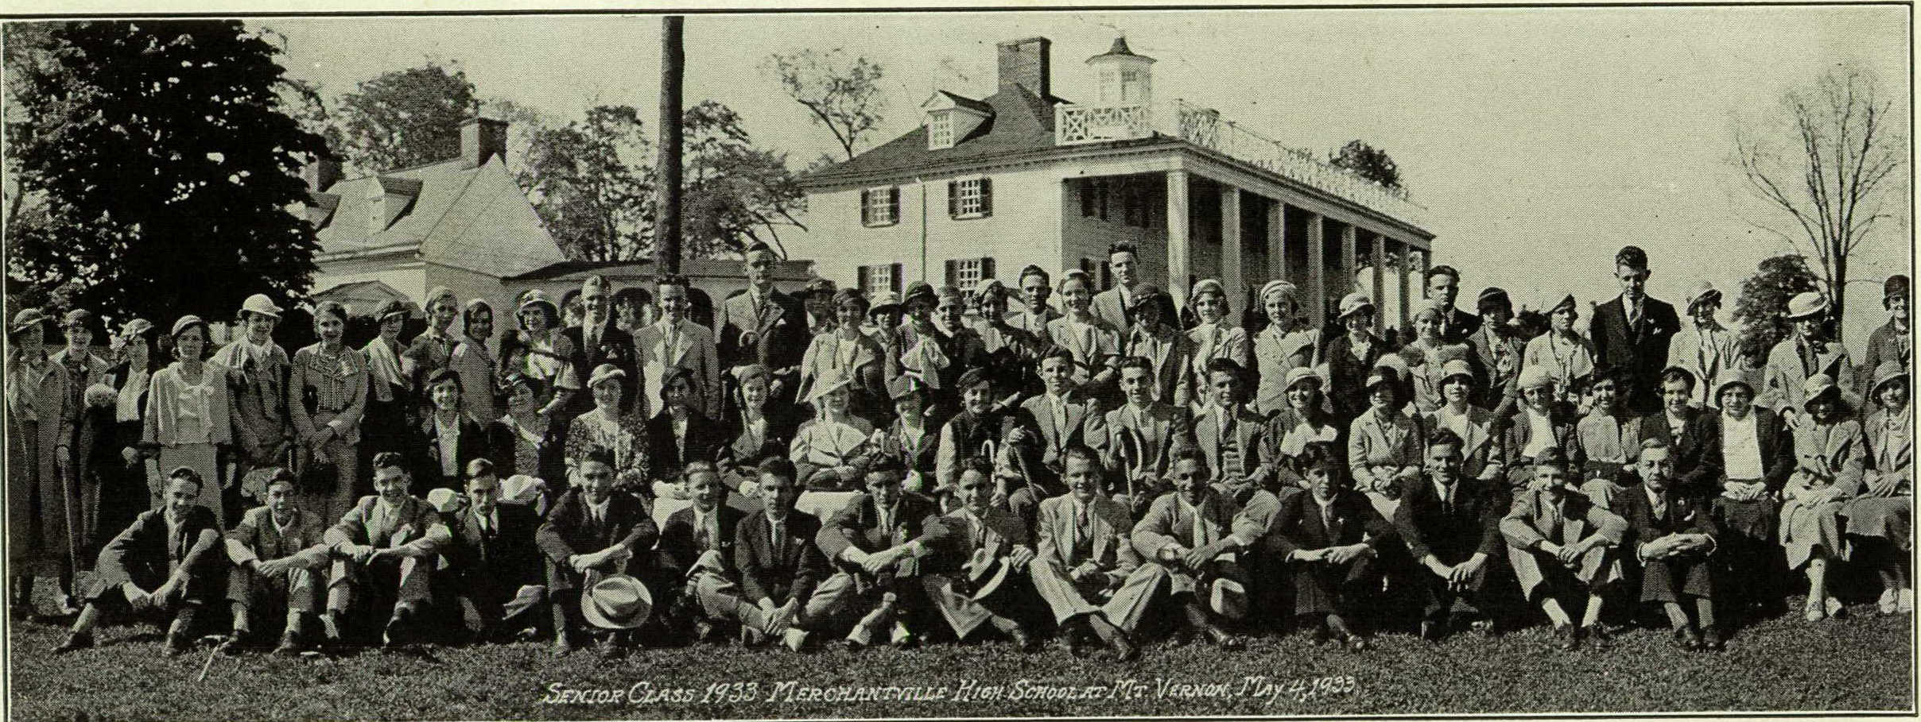
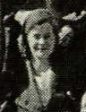
Graduation class of Merchantville, New Jersey, May 4, 1933, at Mt. Vernon.

Slide 23
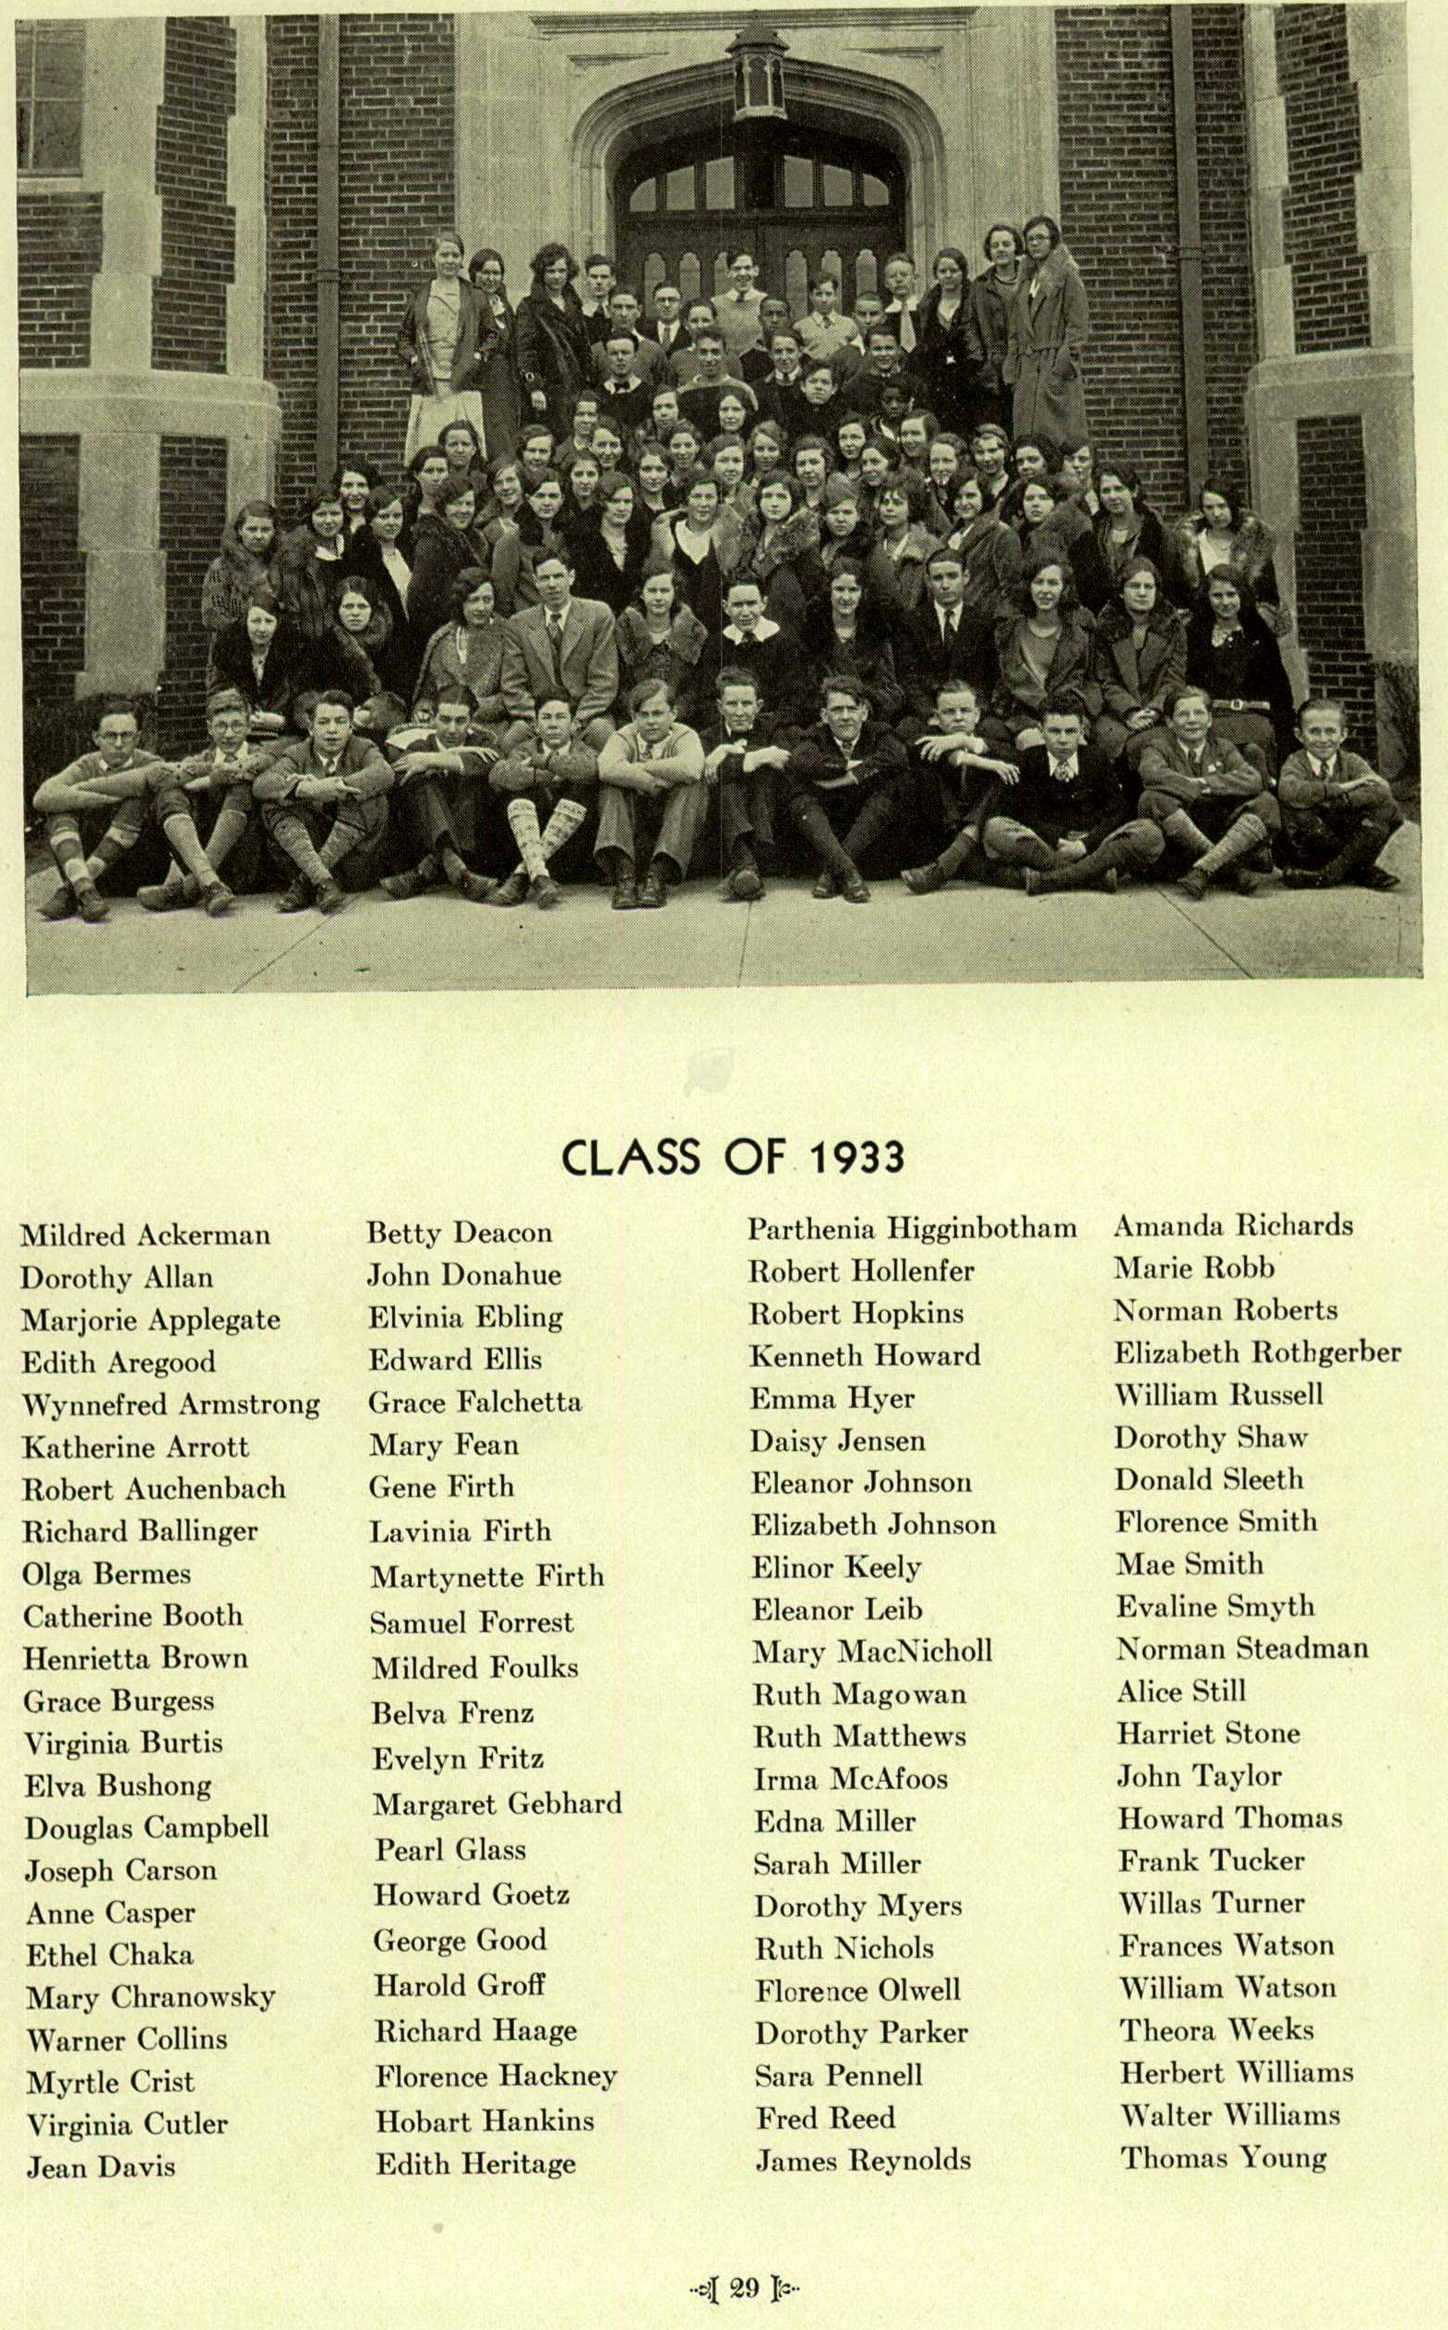
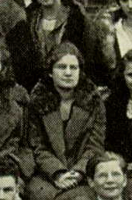
Graduation Class, 1933
23

Slide 24
Mary states in her autobiography
that she knew her father would not cash out
a life-insurance policy, so she could attend
Drew Theological Seminary in New Jersey.
It was the Depression, and money was tight.
.
She chose to attend Temple University
in Philadelphia and drive back and forth
from Merchantville, New Jersey,
instead of living on campus
She elected to add “teacher college courses to my straight Liberal Arts.” **

Slide 25
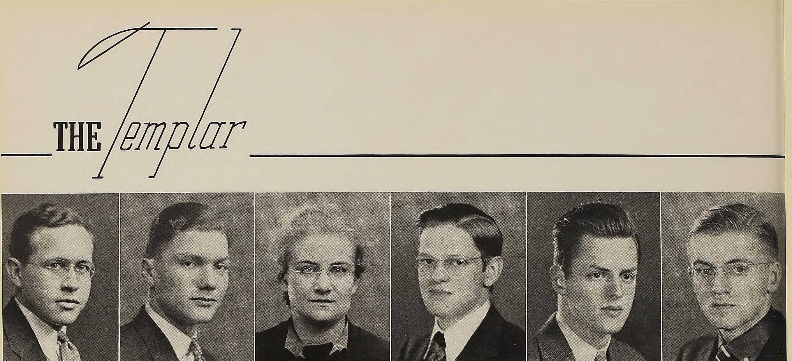
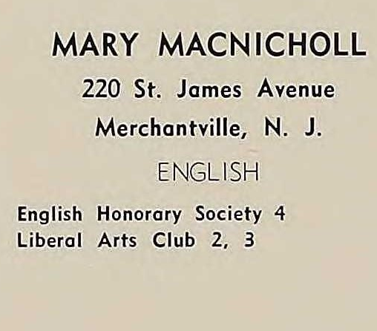
Mary MacNicholl,
Student at Temple University

Slide 26
After graduation,
Mary MacNicholl endured more challenges
and disappointments
but learned valuable lessons
along the way.

Slide 27
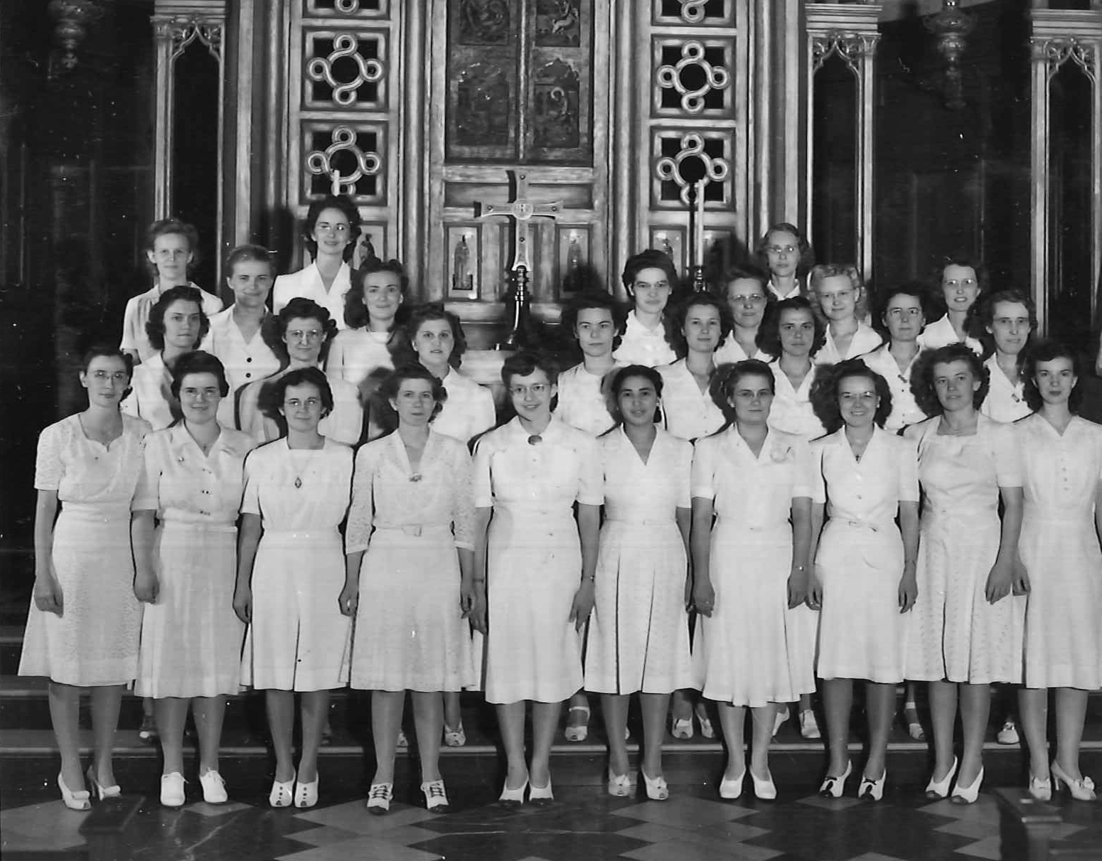
Candidates of the Woman's Division of Christian Service of the Board of Missions and Church Extension
Board of Missions of the Methodist Church , “Mission Photograph Album - Portraits #06 Page 009,” UMC Digital Galleries, accessed August 10, 2018, http://catalog.gcah.org/omeka/items/show/60333.

Slide 28
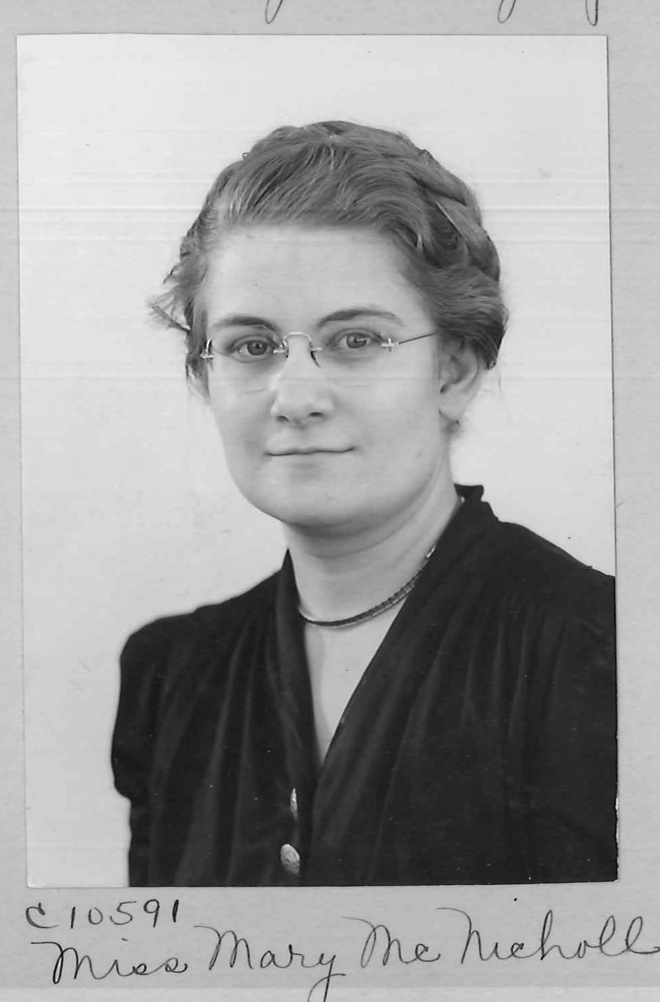
Mary MacNicholl
after graduation
from Temple University,
as she begins a career with the Board of Missions, and leaves for New Mexico where “she became a valuable teacher who learned a lot from her duties and was concerned for the welfare of her students.”
Mission Photograph Album - Portraits
1940s - 1950s
Board of Missions of the Methodist Church

Slide 29
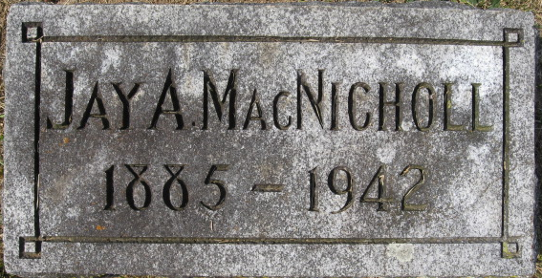
Her father’s death
prompted Mary
to make a few changes
in her life
and follow the path
she had planned for
all her life.
When three years of teaching came to a close in Florida, Mary asked for a sabbatical; “ . . .my dream of the ministry began to come true.”

Slide 30
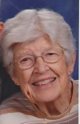

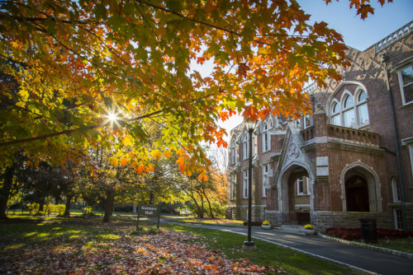
With a stipend from the
Woman’s Division
and a work scholarship, Mary MacNicholl began
religious education
at Drew Theological School in Madison, New Jersey.
At Drew, Mary and Muriel Hayward became dorm mates
and life-long friends.

Slide 31
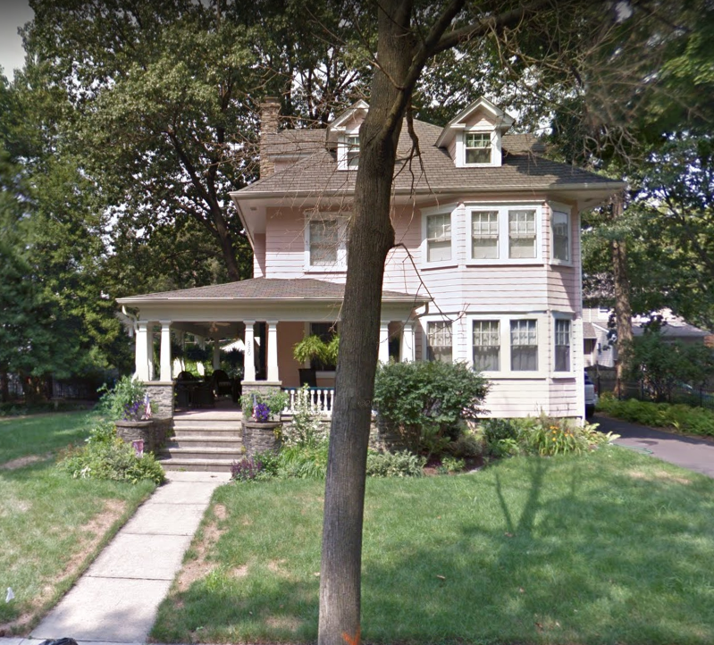
The Jay and Mary Stoll MacNicholl home
220 St. James Ave. Merchantville, NJ
One day, as Mary sat on her home porch in Merchantville, New Jersey, drying her long wavy hair in the sun with a towel, some children came walking up the sidewalk. She heard one young boy say, “Look, an angel!” Another boy, a neighbor to Mary and her family, said, “Nah! That’s no angel! That’s just Mary!”
. . . But Mary MacNicholl would never be “just Mary;” she would be noticed, she would be respected, and even if she were not always comfortable with the job, she would put her “heart and soul into everything she did,” Muriel Neve, her dorm mate at Drew, said.

Slide 33
The next two summers, Mary was a Caravan Counselor for the New Jersey Conference. She was one of the adult counselors for four college students who toured churches for the next seven-week period. As part of her seminary education, she began working with Reverend Roger Squires from the Red Bank Methodist Church in Red Bank, New Jersey, as a youth director “experiencing all phases of the ministry except marrying the living or burying the dead.”**
Asbury Park Press (Asbury Park, New Jersey · Sat, Jul 26, 1947 ·

Slide 34
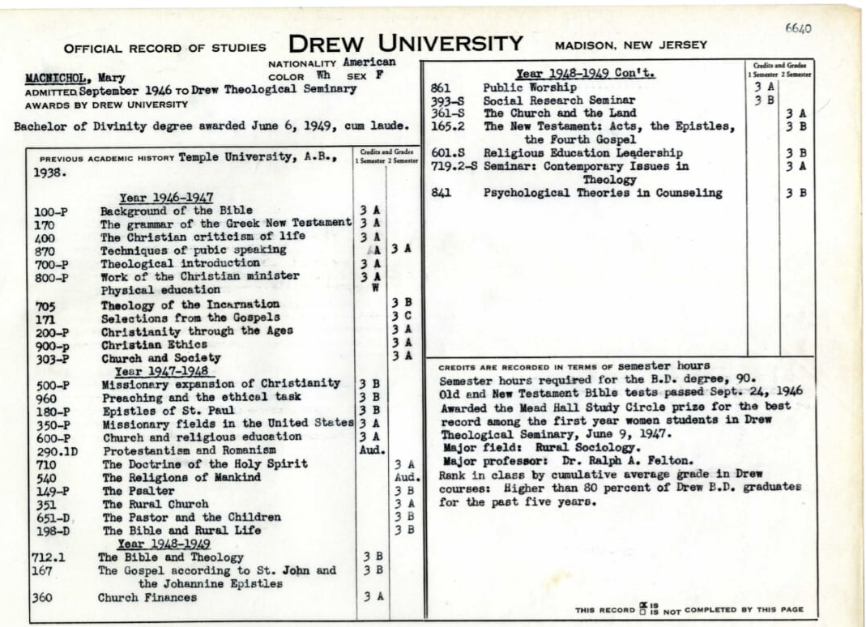

Mary MacNicholl’s Theologicial Transcript indicates she graduated
cum laude from Drew with a Bachelor of Divinity degree in June 1949

Slide 35
Somewhere along the line,
Mary adopted a new wardrobe.
As if she had taken a page out of Anna Howard Shaw’s autobiography about her appearance, Mary MacNicholl also decided years before to dress modestly and wear her hair long. Like she had expressed to Muriel Neve, Mary told Pat Toschak she wore dark colors dresses, pumps for height, and her hair long and braided into a bun at the back of her head for a reason--so as to not allow her “outward appearance [to distract] from her ministry.”
Her desire was “to blend in with her male colleagues as much as possible.” Toschak added.

Slide 36
In 1949 as Mary neared graduation,
she had her head
and heart profoundly tested.

Slide 37
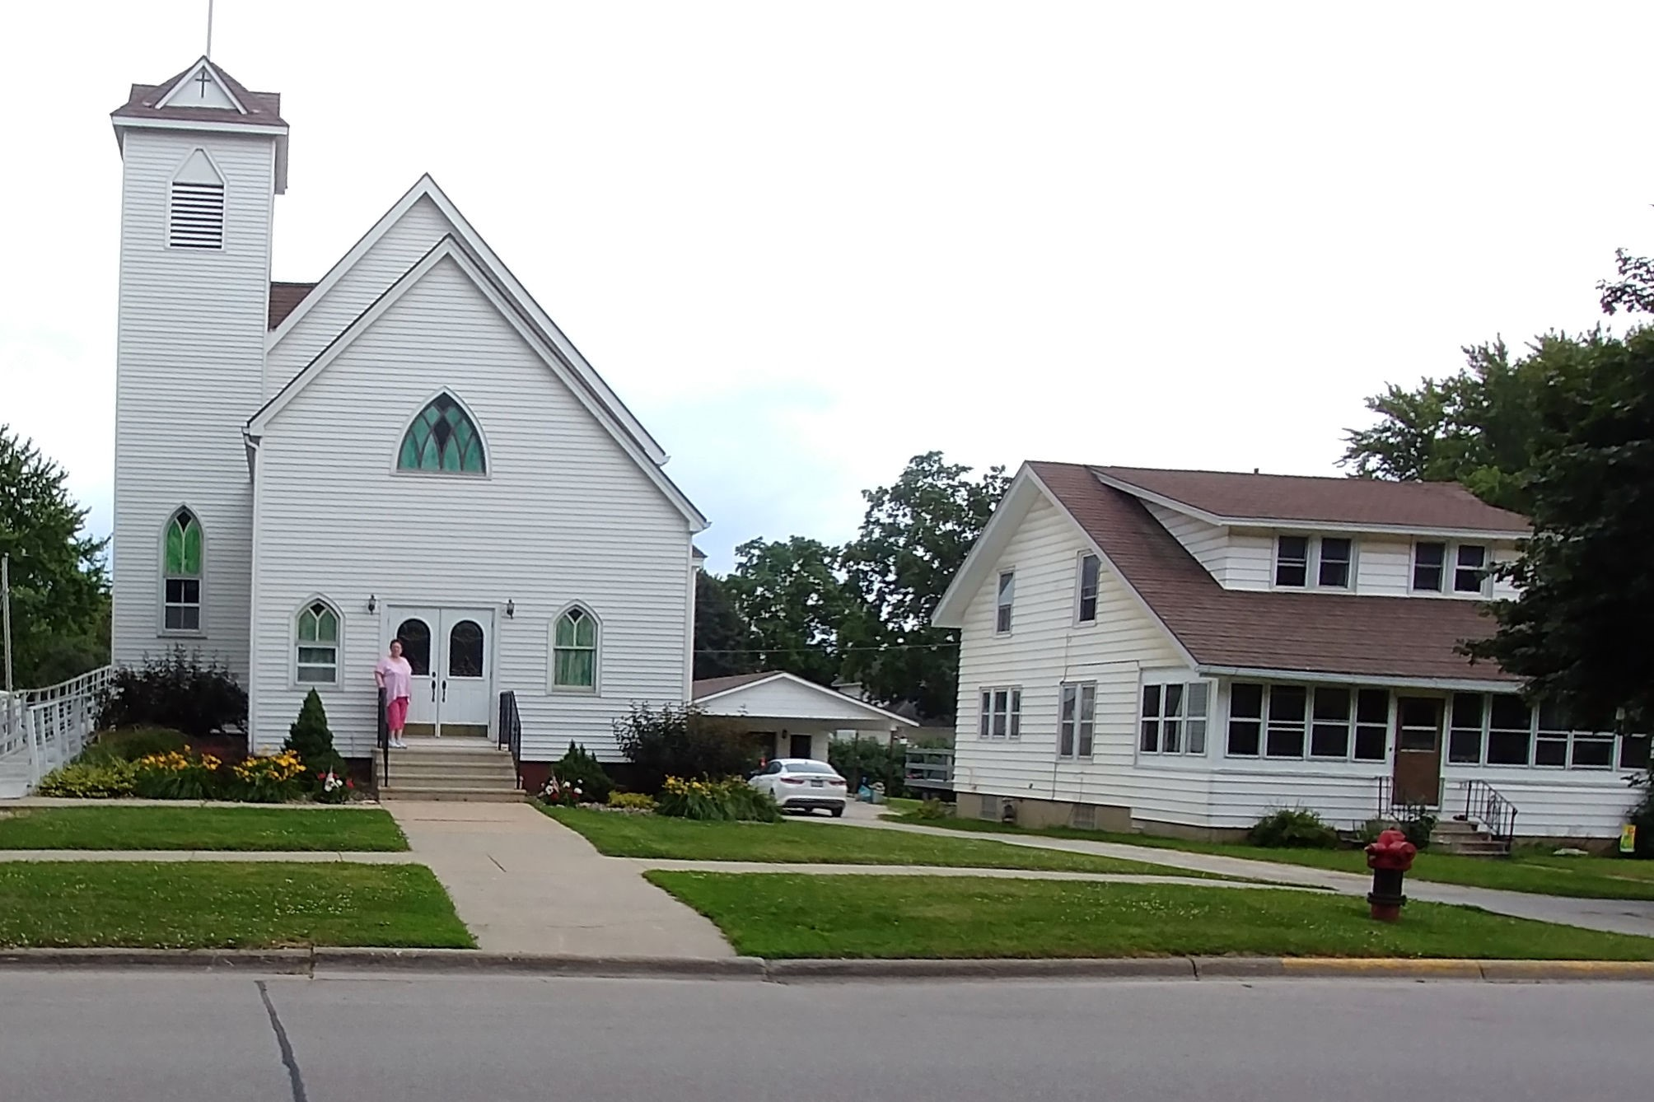
Wykoff Methodist Church and parsonage
Mary MacNicholl had followed her heart,
worked hard to accomplish her goal of becoming a Methodist minister, and would soon deal with different challenges as she started her new career.
“A charge to keep I have . . .My calling to fulfill.”

Slide 38
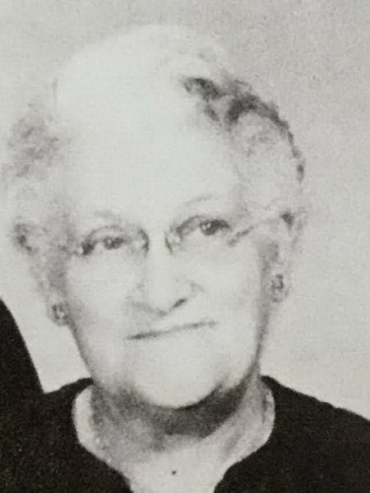
Mary Stoll MacNicholl, Mary’s mother, who agreed to sell her home in Merchantville, NJ, and become her housekeeper for more than 2 decades.
.

Slide 39
In southeastern Minnesota, Mary MacNicholl and her mother made life-long friends: The Walkers, Martins, and others who made her feel comfortable and who she could count on to help her when she needed help.**

Slide 40
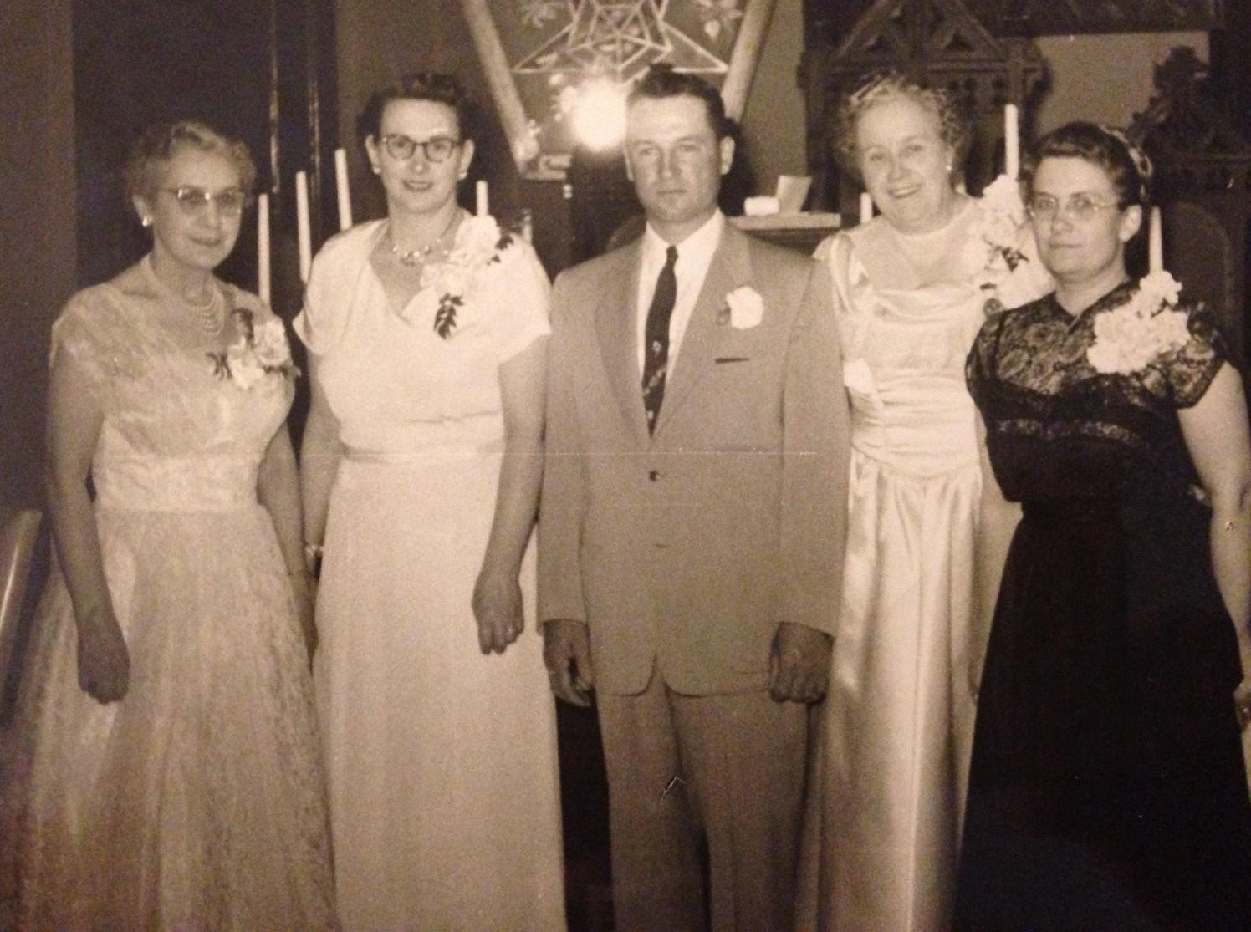
In the southeastern part of Minnesota,
Mary took on many different roles.
“Rev. Miss Mary MacNicholl
was a member of Robert Morris
Chapter 41
in Spring Valley MN. She joined June 8, 1954 and demitted (resigned) May 13, 1970.
(Picture provided by Pat Toschak; Information provided by Eastern Star.)

Slide 41
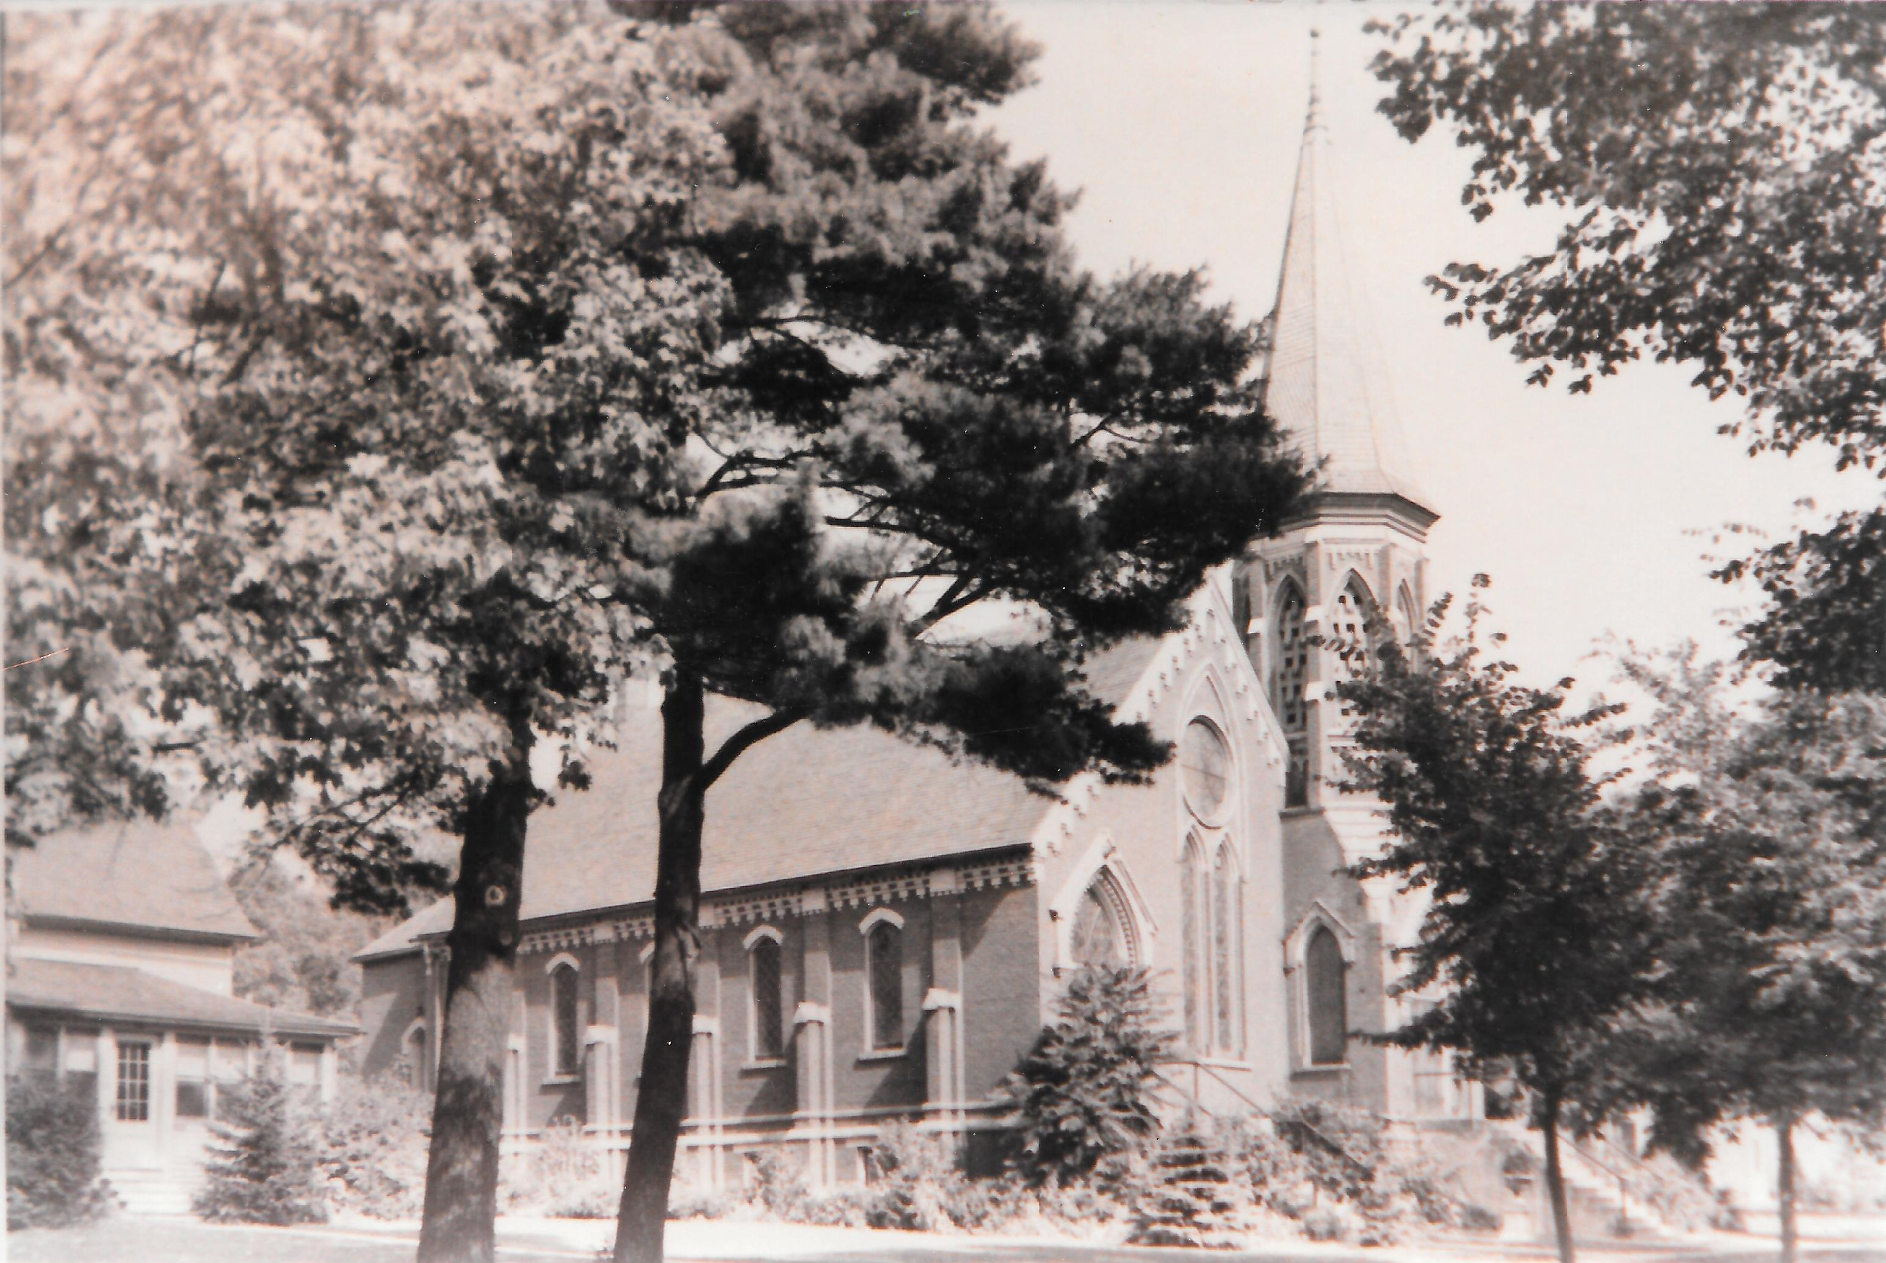
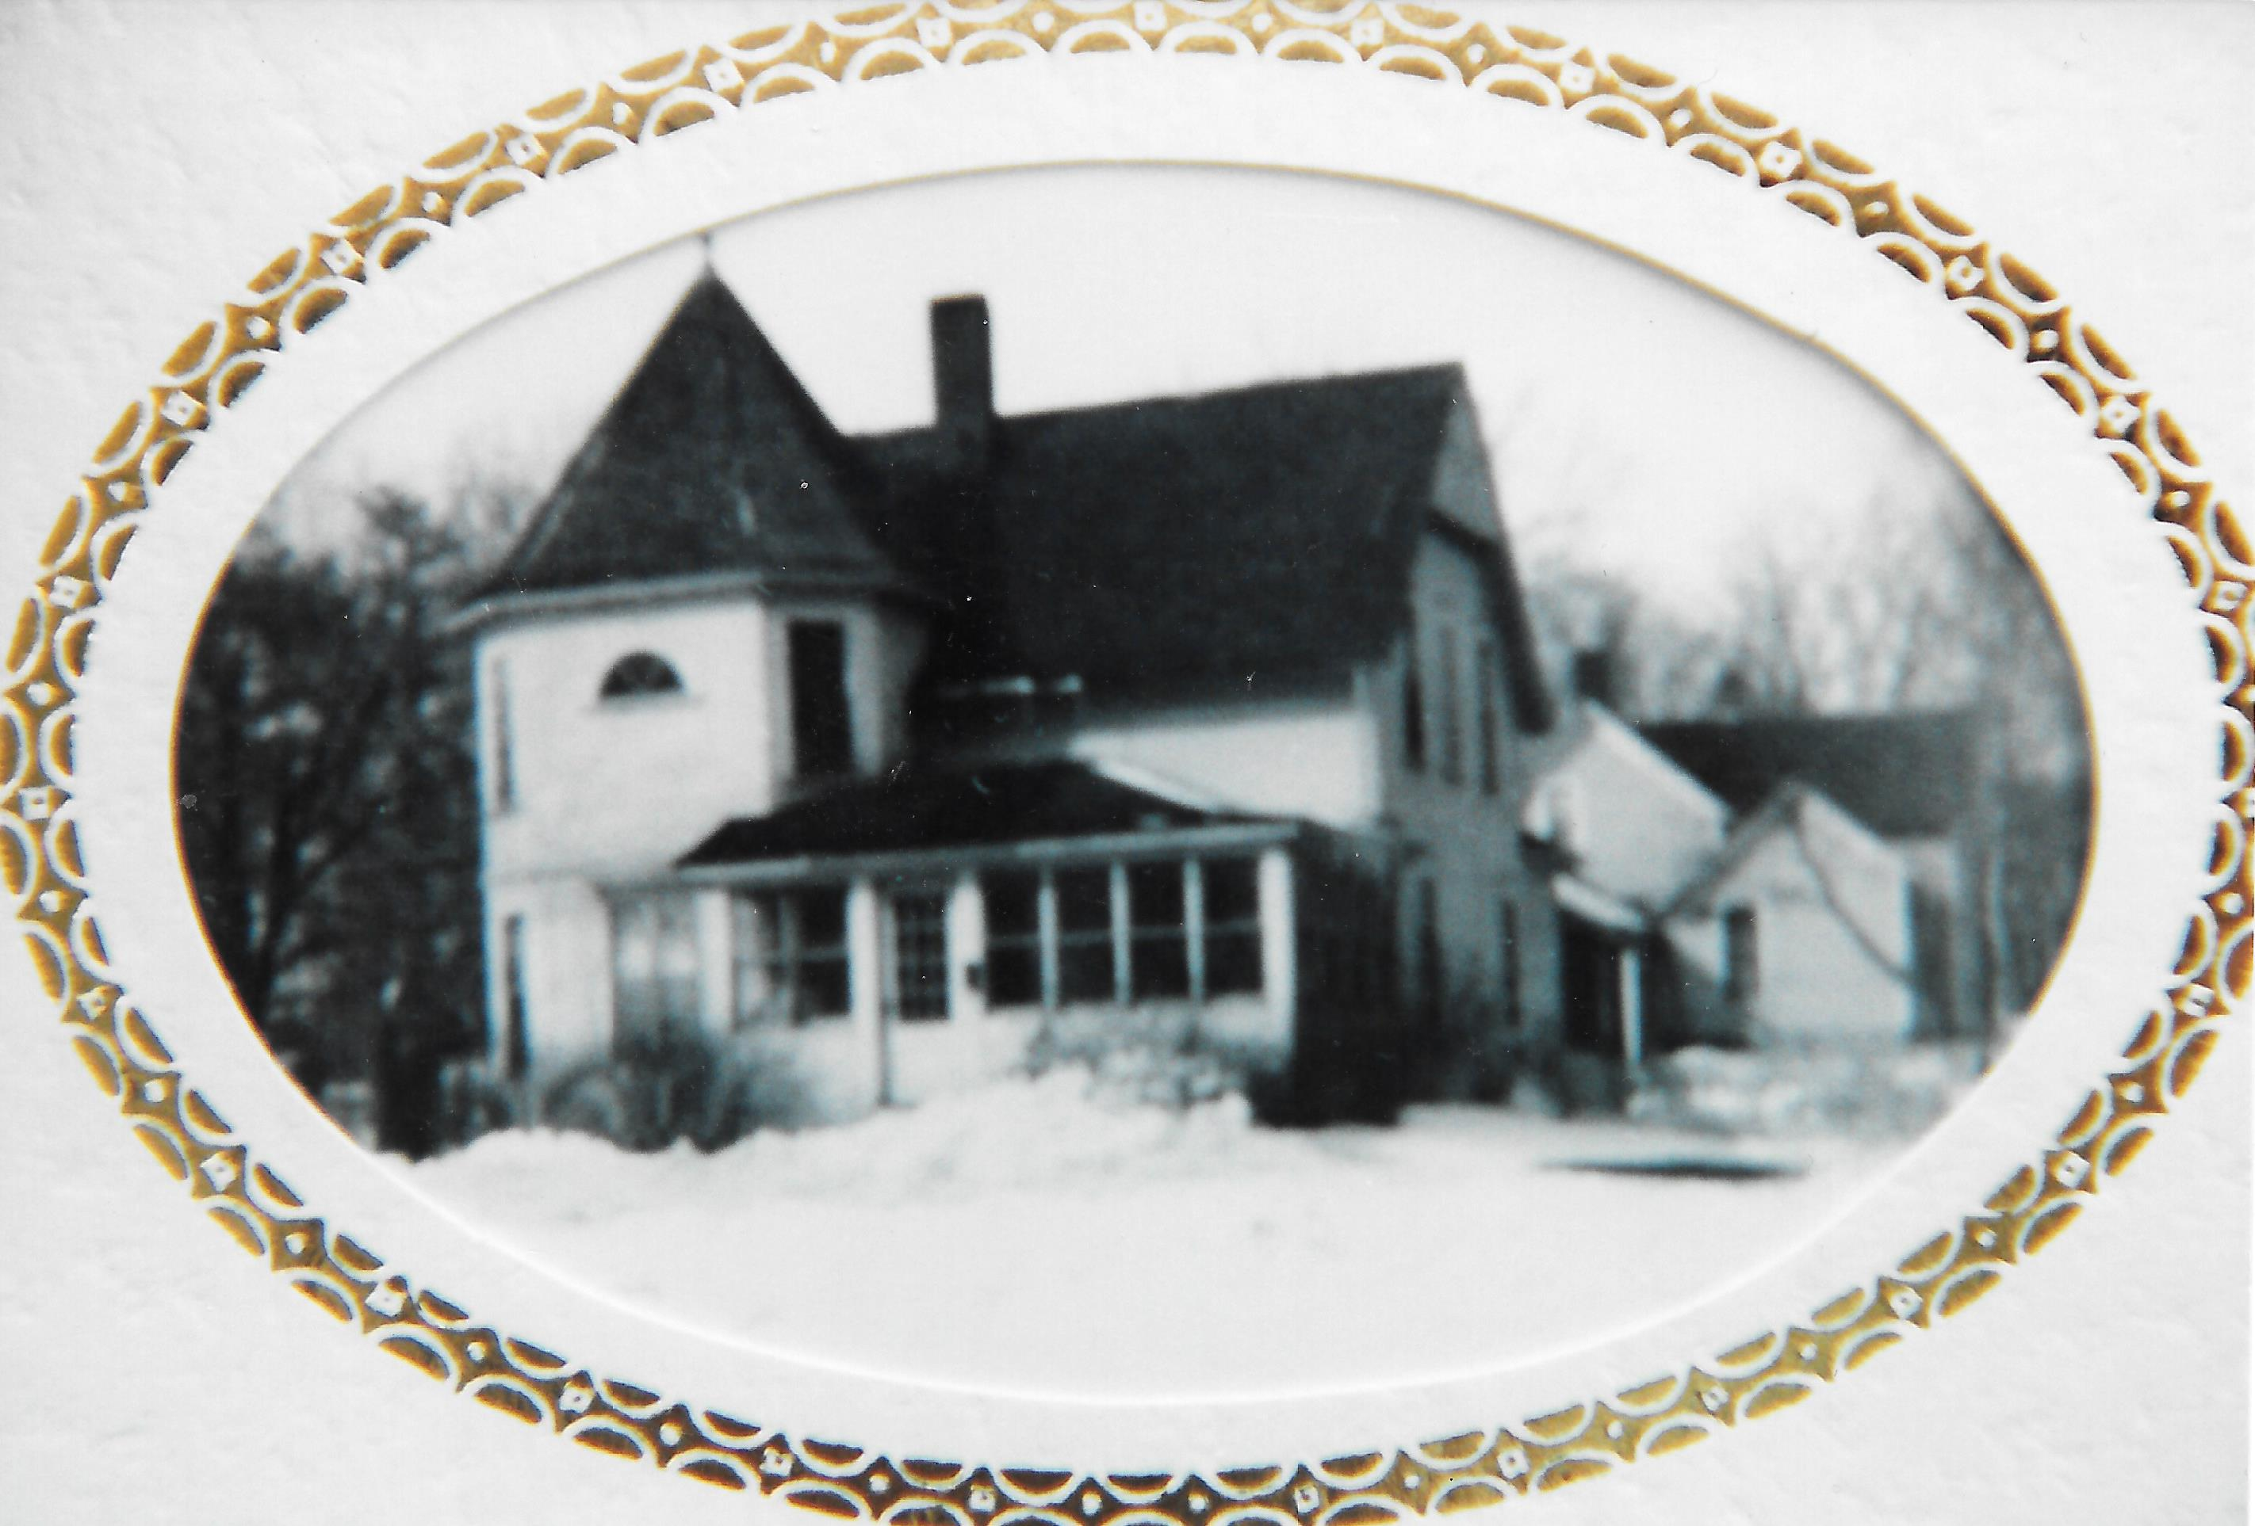
In 1955, District Superintendent Doctor Groenig
appointed Miss MacNicholl to Spring Valley
where she faced a few challenges
Spring Valley Parsonage sat next door.
Spring Valley, Minnesota, 2nd Church
Mary Mac served.

Slide 42
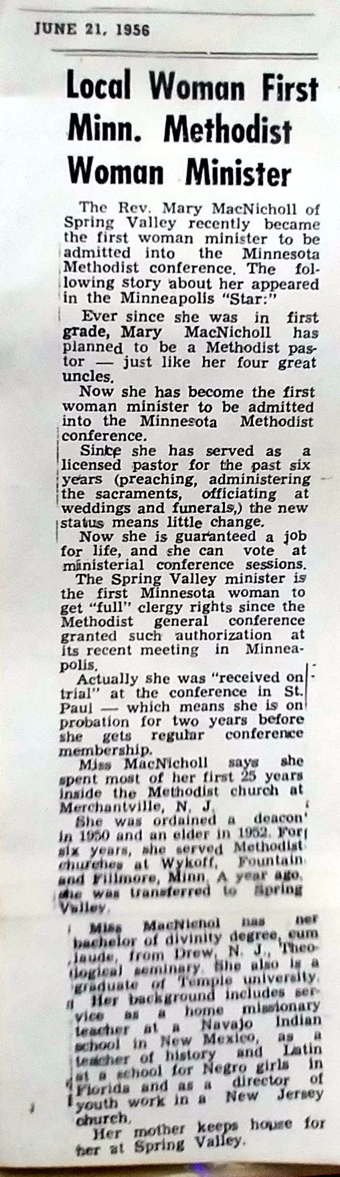
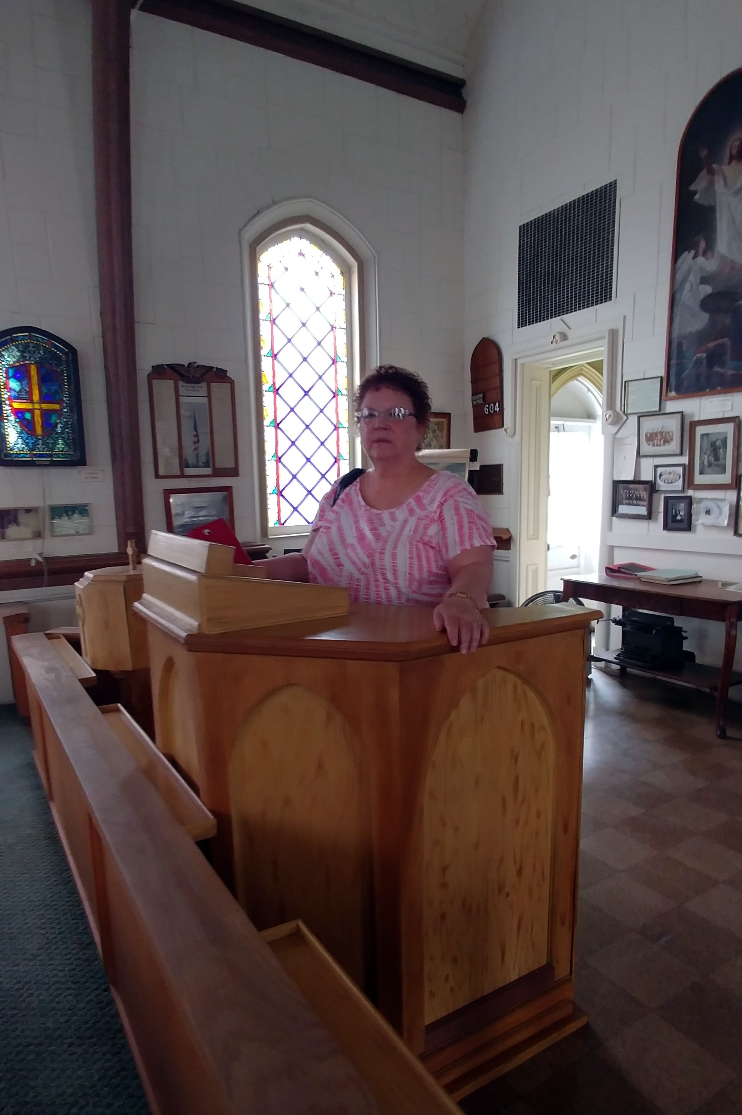
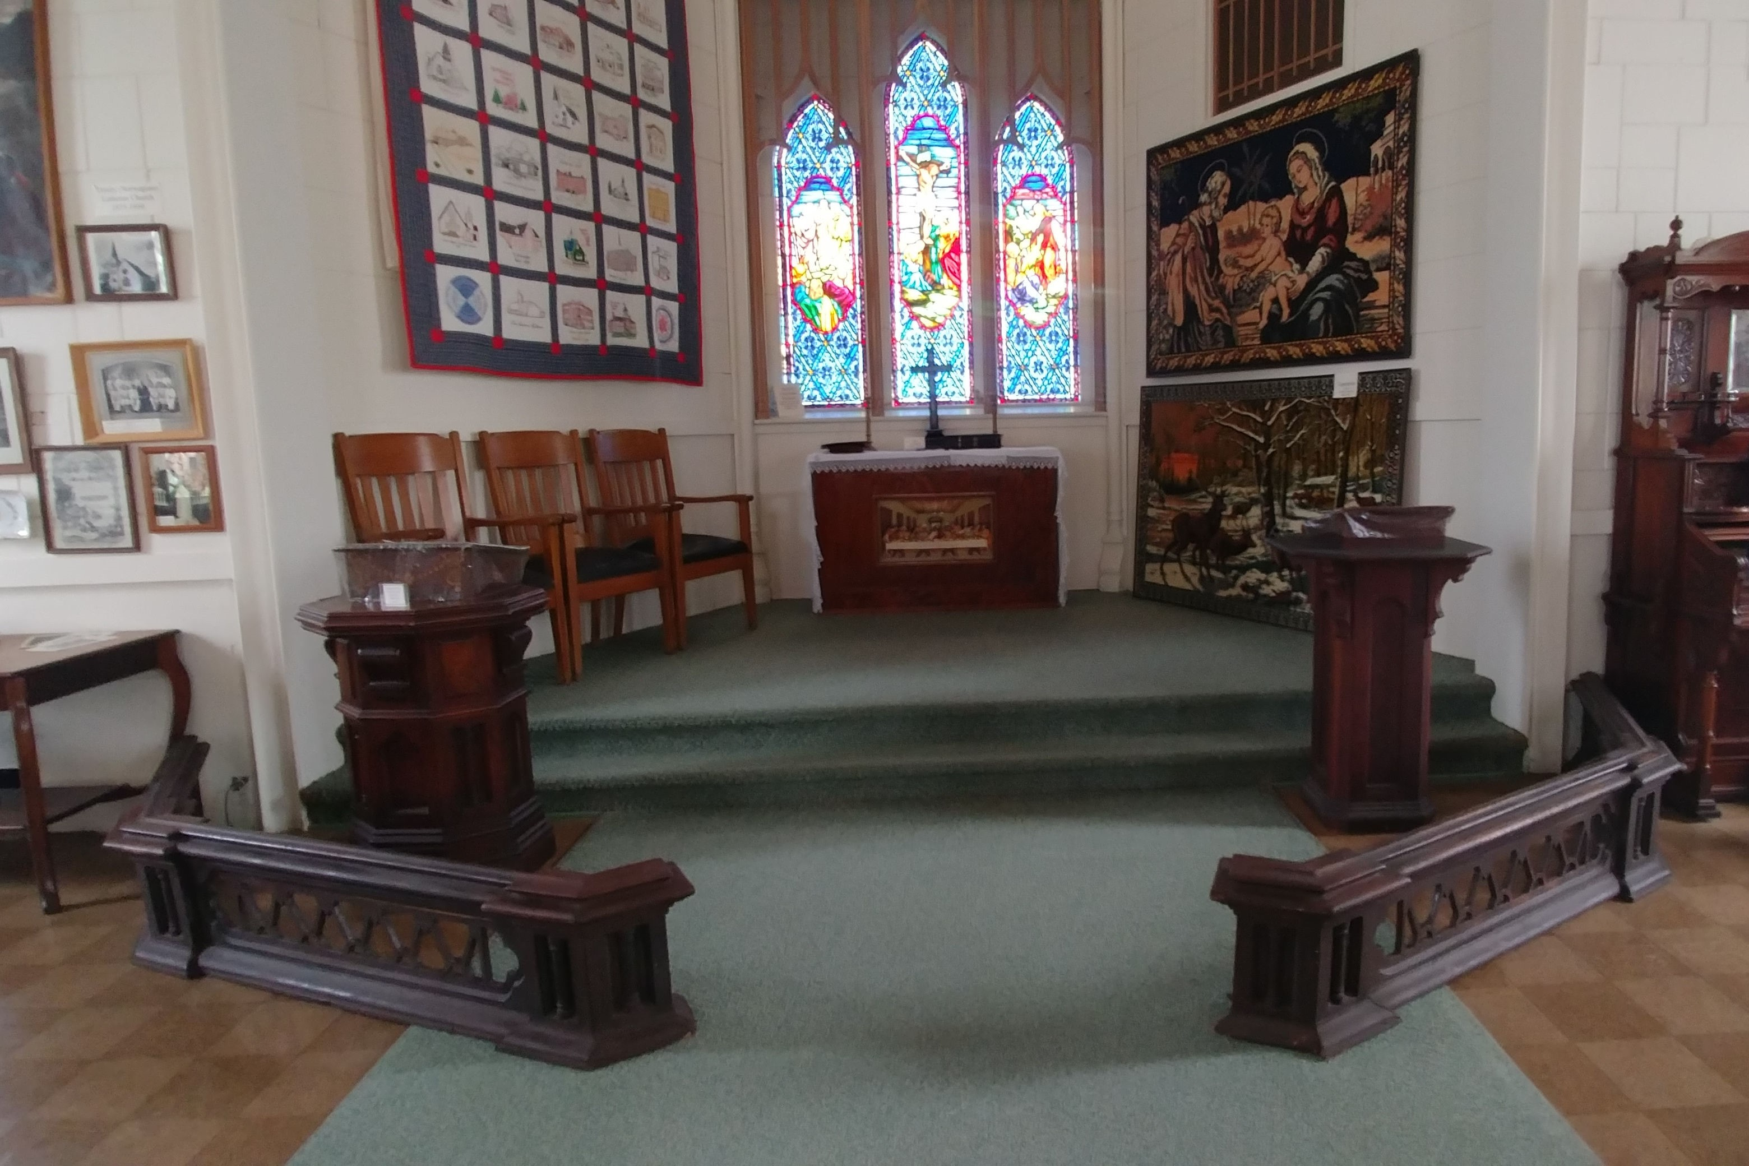
. At forty years old, and despite a raise of $1000, she had reservations about taking this job. One reason was that she would have to fill the shoes of the previous pastors--eighteen years of the “popular Harry Evans and two years of Alquin Toews.”

Slide 43
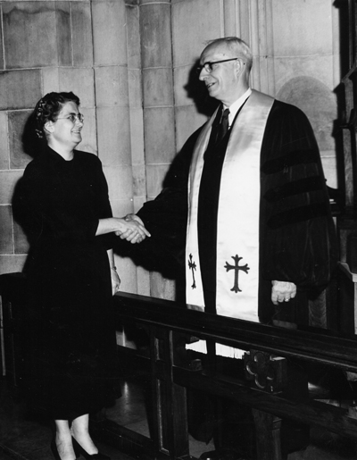
Mary MacNicholl’s dreams
finally came through.
Probably the most gratifying experience for Mary MacNicholl’s own personal accomplishments happened “in 1956 when women were granted membership in Conference. [By 1958], I was amazed and gratified that Minnesota Conference by the necessary ¾ vote elected me to membership. I was the first woman in Minnesota and the 12th in the United States” to be a fully ordained Methodist minister. (Some records state that she was the 11th woman pastor in the United States.)
Mary MacNicholl and Bishop Coors
at Hamline University 1958
at her ordination

Slide 44
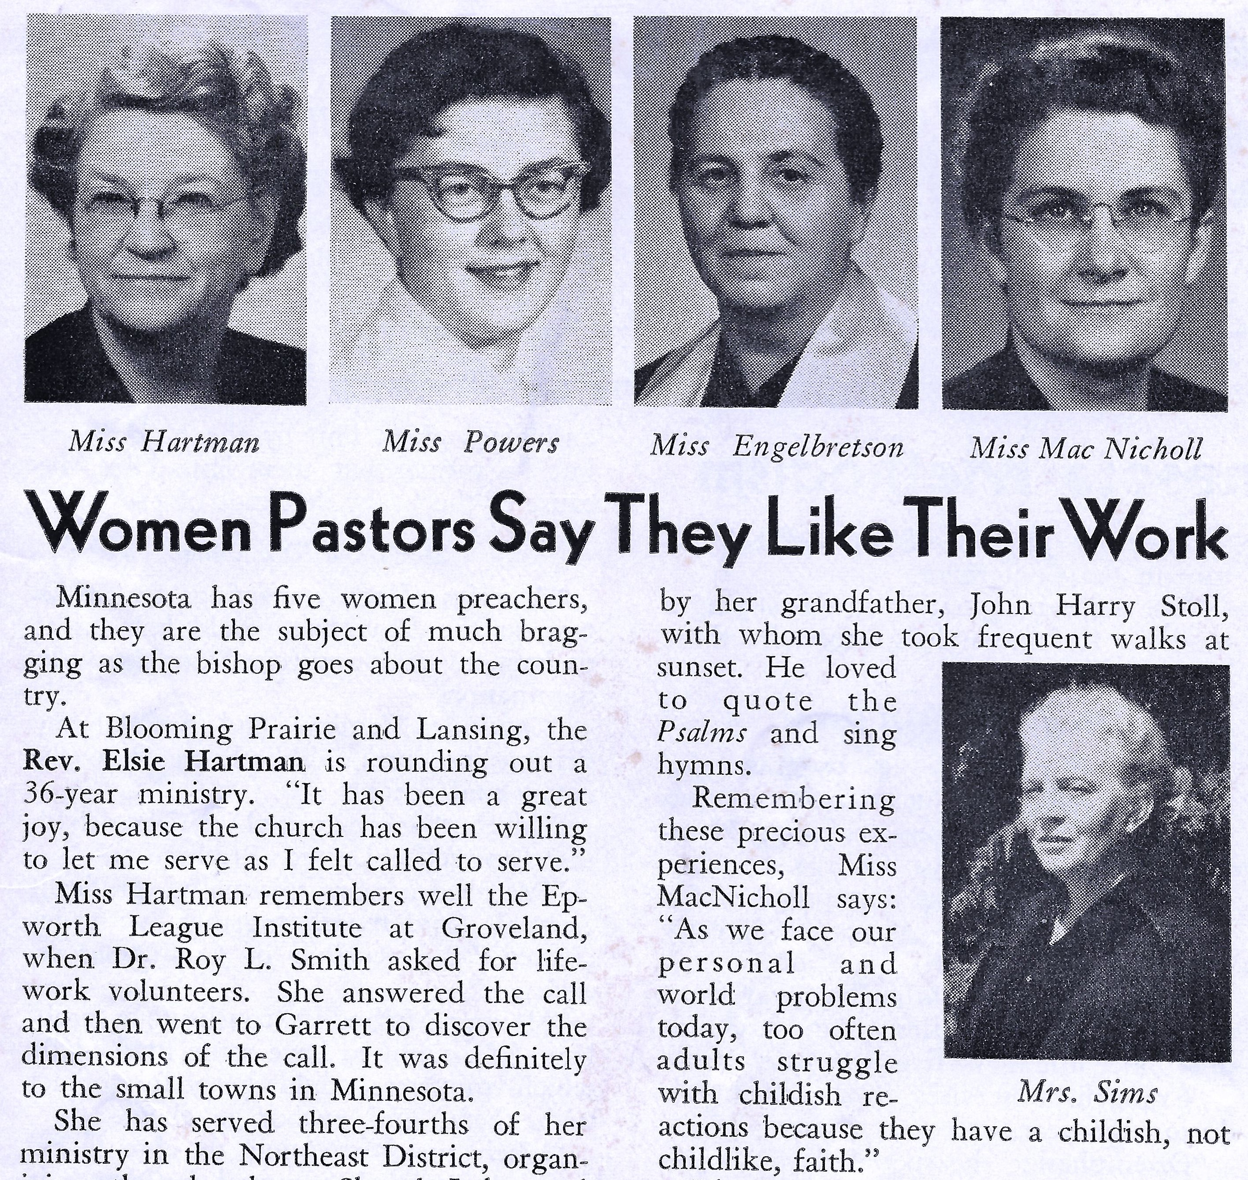
While Mary MacNicholl wasn’t the first to become a minister, more and more women entered the ministry, became fully ordained, and gave their input on their careers

Slide 45

By 1958, Mary MacNicholl
knew it was time to move on
She and her mother packed up their belongings, said their goodbyes, and moved to Becker in the Central Minnesota District.
Here she began the most “creative part of her career.”
She would be part of a pioneering and “cooperative parish” to be ministered by Delton Krueger of Princeton and Spencer Brook, Douglas Norris of Milaca, Estes Brook, Glendorado, and Santiago, and Mary MacNicholl with Becker, Clearwater, and Clear Lake “were to be appointed to serve 9 churches.” Other ministers and denominations would eventually join as well.

Slide 46

4 Pastors, 9 Churches, One Parish

Slide 47

“She leads Becker Congregation
in worship”
The nine (ten)-parish concept gave each of the ministers more freedom
and strength.
They may have had to “live and serve in separate communities, [but] they [were] more involved . . .in the day-to-day lives of their parishioners.”
Each pastor took care of his and her assigned charge.
Yet the “parish leaders cultivated the idea that each . . .is a pastor to the entire parish” where they use their “special abilities.”

Slide 48

Mary put her heart and soul into everything she did
Mary MacNicholl already learned
she could make
her own
incomparable contribution,
one issue at a time.
When Reverend Mary took her stance
in the pulpit,
she exhibited confidence, intelligence,
and a will
for the congregation
to have a deeper understanding
of their designed purpose
even if she had to stand on tiptoes to do so.

Slide 49
Mary often faced bias about her gender
She was criticized for not being married.
She explained to those who criticized her mission that she was not married, and that for every 100 men, there was 106 women. With her usual wry sense of humor, she asked them how they expected her go home and ask her husband a spiritual question. “Are you suggesting polygamy?”
She avoided marriage because she knew the argument would be that she would not have time to serve the church and her husband and family.

Slide 50

Yet, the parish pastors worked hard to build each other up
. One of them, Doug Norris, Pastor of Milaca, Santiago, and Fellowship (Glendorado-Estes Brook), argued that most churches denied women the pulpit for too long. In a sermon entitled, “Are women fit to be ordained?” he spoke, he admitted:
He was proud that Minnesota, unlike most states, had allowed women to take their places in their pulpits.
From the time of Wesley, women had to climb a long, up-hill battle to get where they were.
“Mary was classic! She wore a black dress in the winter, a gray dress in the summer, rimless glasses, her hair in a pug, and a hat. With the Bible under one arm, and the Methodist Book of Discipline under the other, those rural Minnesota Methodists didn't know what hit them!”
http://www.dougnorris.com/SermonPost08/9-23-12.html

Slide 51

Stewardship was important to Miss MacNicholl
Reverend Mary MacNicholl wrote in her 1963 Ministerial Report that after the Clearwater board finalized their financial statement, funds were released for improvements. Eave troughs were installed, a well was dug, bathrooms were built, faucets with hot and cold water were plumbed into the building, new cement steps were poured, and wrought iron railings were mounted making “the old church far more adequate for present-day church activities.”
Clearwater United Methodist Church--1857

Slide 52

1964 Clearwater Methodist Confirmation Class
“Report of Pastor” for the period between June 1, 1963 to December 31, 1963, Reverend MacNicholl wrote that during her “pastorate the spiritual life of the Church has been nourished . . .”
Conversation with friend Barb, her brother Jim and sister Sue, and father Bob who is 94 years old and very hard of hearing.
Left to right: Cindy Frank, Kay Kautio, Barb Beech, Mary Lou Adrien

Slide 53

Together magazine spotlighted
the 9-church Central Minnesota parish activities in October 1964
United Methodist Conference, Kathy Johnson, Clearwater UMC, and Frank family scrapbook

Slide 54


1964 Parish Festival in Glendorado, Minnesota,
“geo-graphical center” of the 9 churches
Jesus blessed the little children.
Eight hundred parishioners attend.
Harold, Becky, and Winnie Frank
took communion.

Slide 55

The theme is “The heart of Christ is the heart of Minnesota.”

Slide 56
Stewardship was important to Miss MacNicholl
She saw to it renovations of the old church were made
Reverend Mary MacNicholl wrote in her 1963 Ministerial Report that after the Clearwater board finalized their financial statement, funds were released for improvements. Eave troughs were installed, a well was dug, bathrooms were built, faucets with hot and cold water were plumbed into the building, new cement steps were poured, and wrought iron railings were mounted making “the old church far more adequate for present-day church activities.”

Slide 57

Other events that fulfilled her “creative” spirit
Helped with development of Sherwood Fish and Wildlife Refuge
Bishop Nall appointed her to the Methodist Board of Ministry
After a series of pastor suicides, Mary’s concern was for a Mental Health Program [for] ministers
Helped bridge the gap between races by educating, supporting, and celebrating men and women of all races
Miss MacNicholl encouraged her congregations to learn about other cultures as well as when the Clearwater Methodist Church hosted a “Tafaddal.” Translated to mean “Come and Eat.”
Along with Bishop Nall, she joined other Minnesota clergy and lay people in an interfaith, anti-war campaign, Clergy and Laymen Concerned About Vietnam, or CALCAV, in Senator Walter Mondale’s office in Washington, D.C. in February 1968.
Yet Miss MacNicholl who had overseen many creative events in the Central Minnesota Parish, would not be leaving before she saw one more monumental task come into being, the Uniting Conference Service of the Methodist and the Evangelical United Brethren (EUB).

Slide 58
For everything there is a season:
Mary Sr.’s health began to fail in 1967
She received notice she would be moving on to western Minnesota—Milan and Appleton.

Slide 59

Many in western Minnesota were excited to be joining forces with other churches to form a working parish.

Slide 60

Appleton, MN, United Methodist Church
Mary Mac’s last charge in Western Minnesota
https://www.google.com/maps/uv?hl=en&pb=!1s0x52cb16defec2225b:0xd192022794052d64!2m22!2m2!1i80!2i80!3m1!2i20!16m16!1b1!2m2!1m1!1e1!2m2!1m1!1e3!2m2!1m1!1e5!2m2!1m1!1e4!2m2!1m1!1e6!3m1!7e115!4shttps://lh5.googleusercontent.com/p/AF1QipPbHIQL5g70p8CzNWJgUBOB5hV_Oj2ODx0CBW01%3Dw284-h160-k-no!5sappleton+mn+united+methodist+church+-+Google+Search&imagekey=!1e10!2sAF1QipPbHIQL5g70p8CzNWJgUBOB5hV_Oj2ODx0CBW01&sa=X&ved=2ahUKEwikzbPttf_cAhUi0oMKHVRvBoIQoiowCnoECAoQCQ

Slide 61

Her mother went with her to Appleton, but her health was still not good
Her uncle Arthur was sick and came to stay and be taken care of by the two Mary’s.
He died in Appleton
John and Helen MacNicholl Romer and Arthur MacNicholl

Slide 62
There were those who held a narrower vision of women’s abilities; there were churches in the parish area that would not align themselves or stay aligned with the Headwaters Parish because Miss Mary, or any other woman, was in the pulpit.
Some “parishioners or fellow ministers” did not always accept he at first. The minister who had formed her opinions early in career while working with the Navaho and at the Boylan-Haven School for Negro Girls had become as liberal in beliefs as her clothes appeared conservative.
As she had done throughout her career, she tried to educate and elucidate awareness of racial inequality. Regrettably, one person, who will remain anonymous, gave witness that some in western Minnesota did not share the same values as Miss MacNicholl, regarding race relations or reparations to any minority group.
In an interview, Jeanne Audrey Powers related, “Mary went through tough times.”
In a letter of response to Miss MacNicholl dated 11 February 1971, Bishop Paul Washburn clarified the situation. “Your desire to remain faithful there in the face of all the untoward circumstances causes me to admire your commitment the more.”

Slide 63

MORE CHANGES:

Slide 64


Slide 65

Parkway Apartments, Philadelphia, PA

Slide 66


Slide 67

DEATH NOTICE
Mary MacNicholl—“to be absent from the body is to be present with the Lord.”
No memorial service will be held. Ashes to be buried in Mount Joy, Pennsylvania.
Memorials: Renew your ordination vows to be a faithful minister of Jesus Christ!
No other memorials needed.
Mrs. Jay A. MacNicholl (mother) and Mrs. H.M. Romer (sister) may be reached at
2601 Parkway, Apt. 1212. Philadelphia, Pa. 19130.

Slide 68
Paradoxically, Mrs. Mary MacNicholl who had had her share of health and age-related problems superseded her daughter in death.
Mary, who had control up to the end, lost a wee-bit when Helen and Mary Sr. asked Rev. Ted Colescott to attend the memorial for her.

Slide 69
Mary MacNicholl may have been short in stature, but she stood tall and strong in spirit.
Her Scotch-Irish and Pennsylvanian Dutch genealogy had developed her faith, leaving large footprints in which to follow and lead.
Like many historic Methodist women, she felt called to enter the ministry.

Slide 70
The first woman to be fully ordained in the Methodist Church in Minnesota,
Mary MacNicholl became the bridge that women who entered the ministry afterwards could look toward to see what had already been done for them.

Slide 72

Clarence Stoll, Arthur MacNicholl wedding pict. Age 28
Photo from Lee Ellis

